Slide 1
Introduction to High Performance Computing (HPC)
Tom August & Josue Rodriguez Gonzalez

Slide 2




What Is High Performance computing?
High performance computers are typically 1000’s of times faster than a desktop PC with many more processors and much more memory and storage space
Desktop PC
CIRRUS
JASMIN
Amazon Cloud
<
x84
<
x1000
<
>5000000

Slide 3
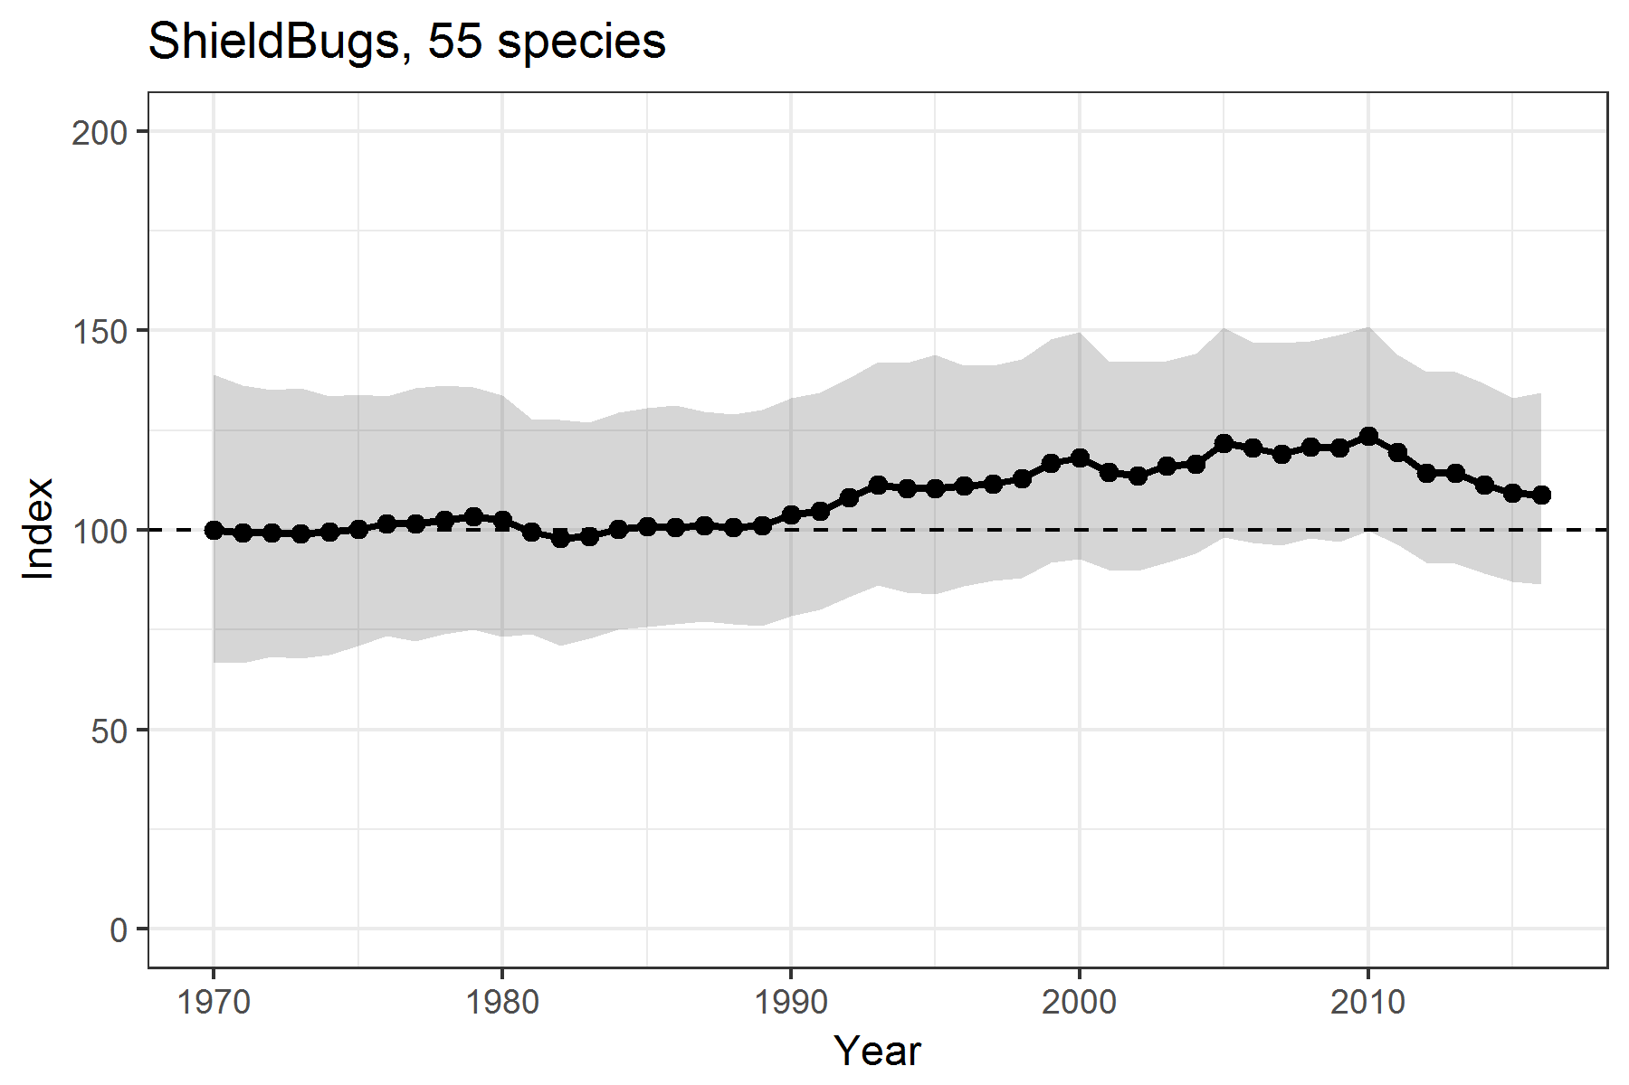
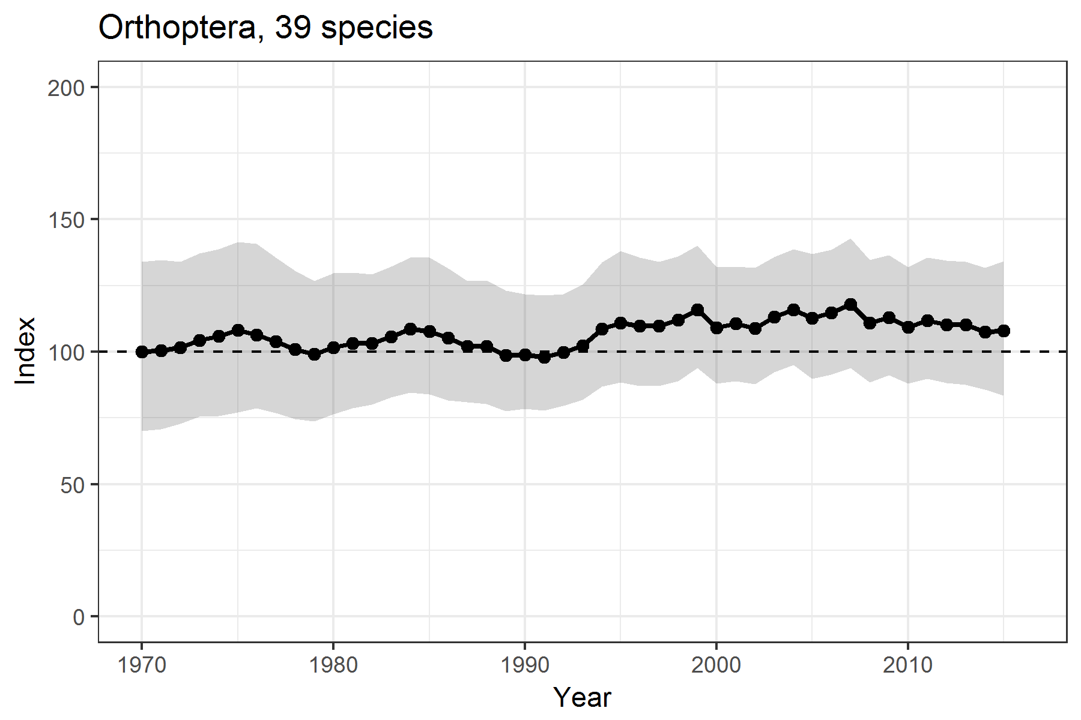
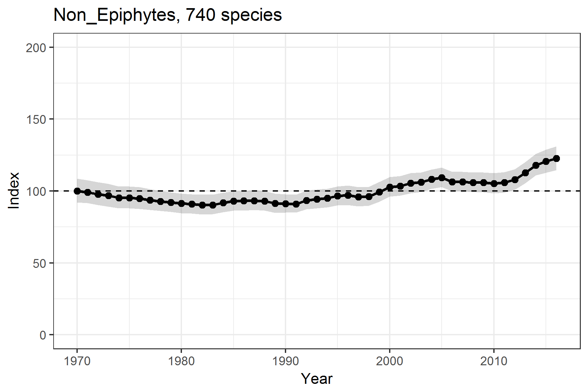
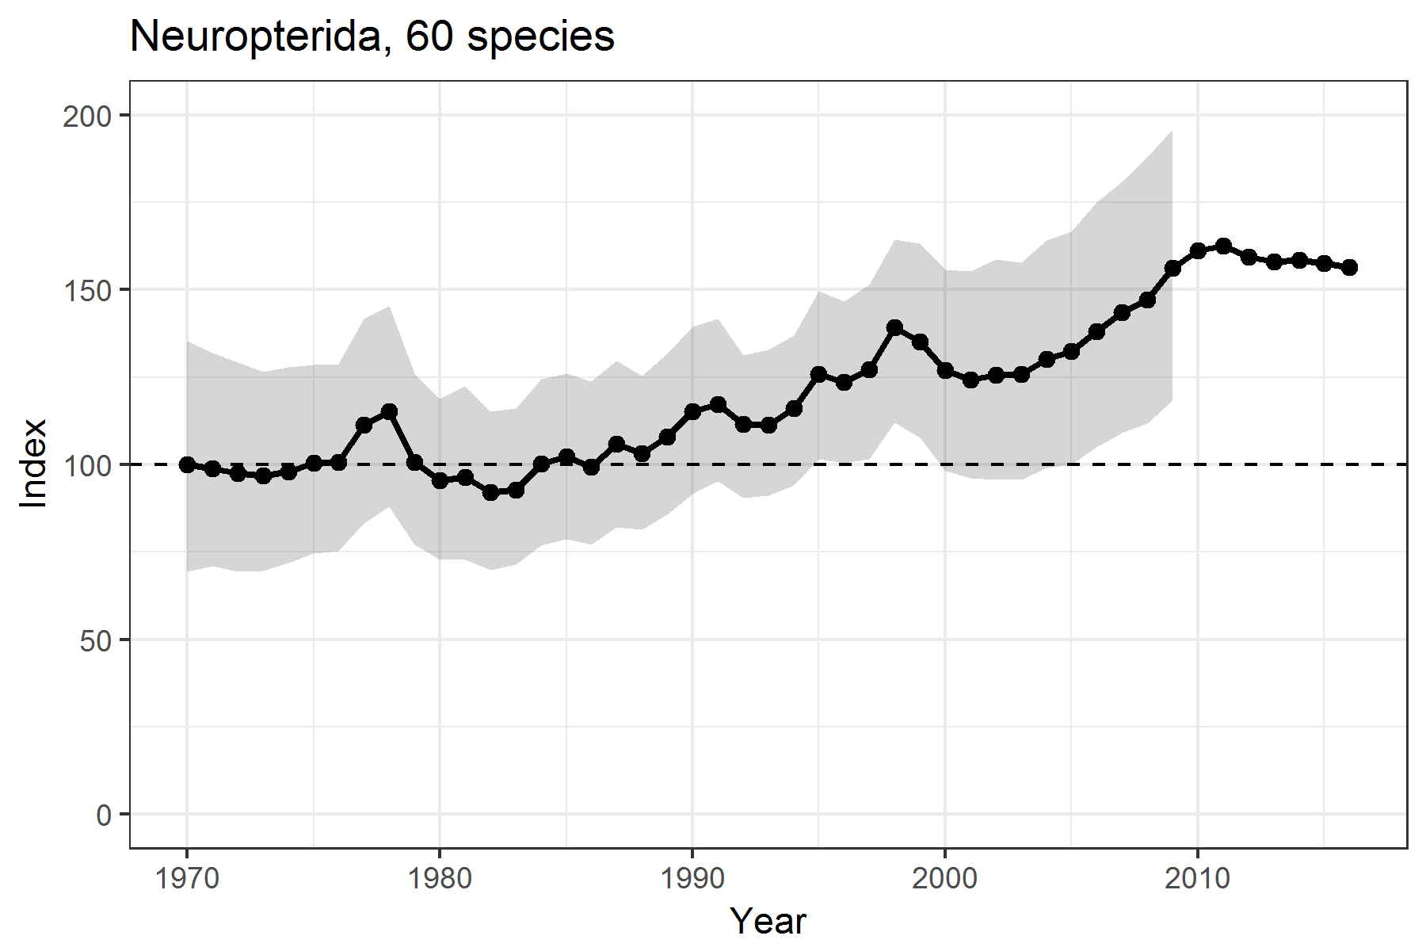
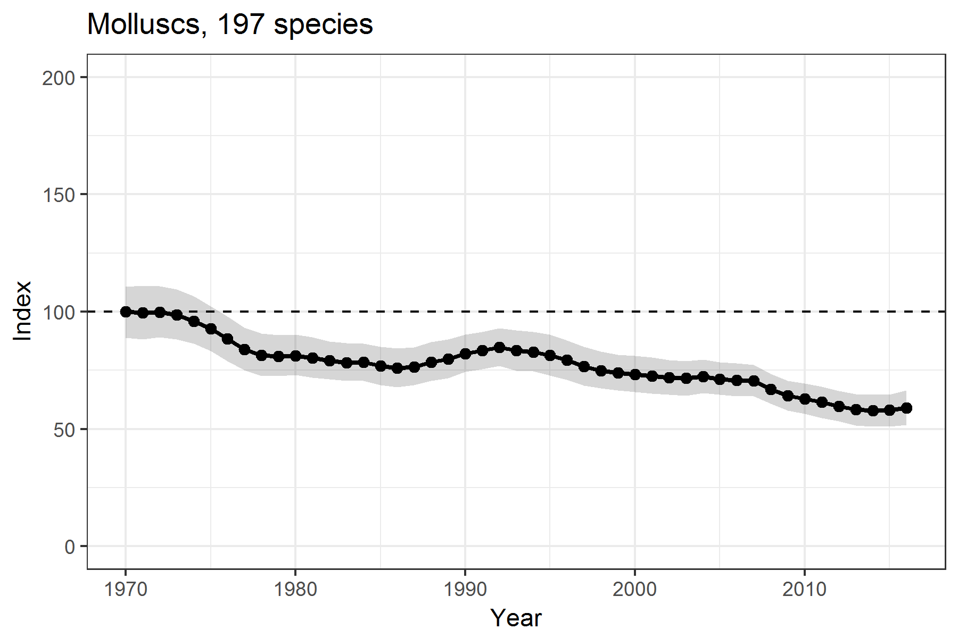
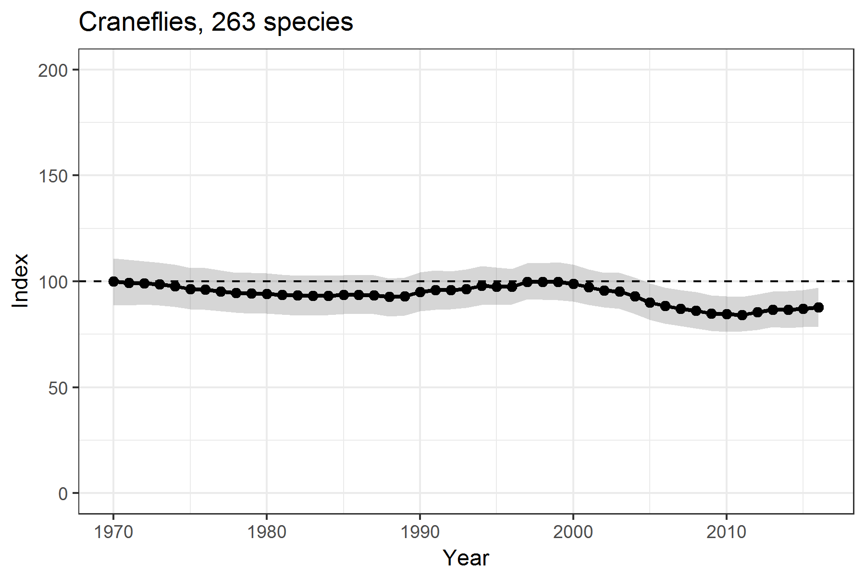

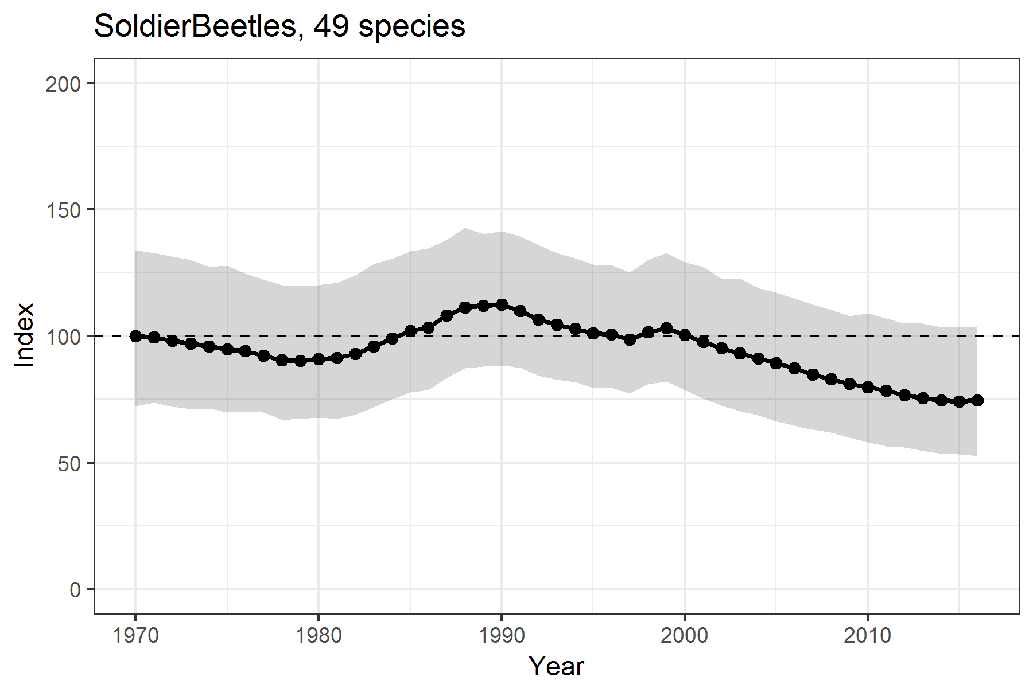
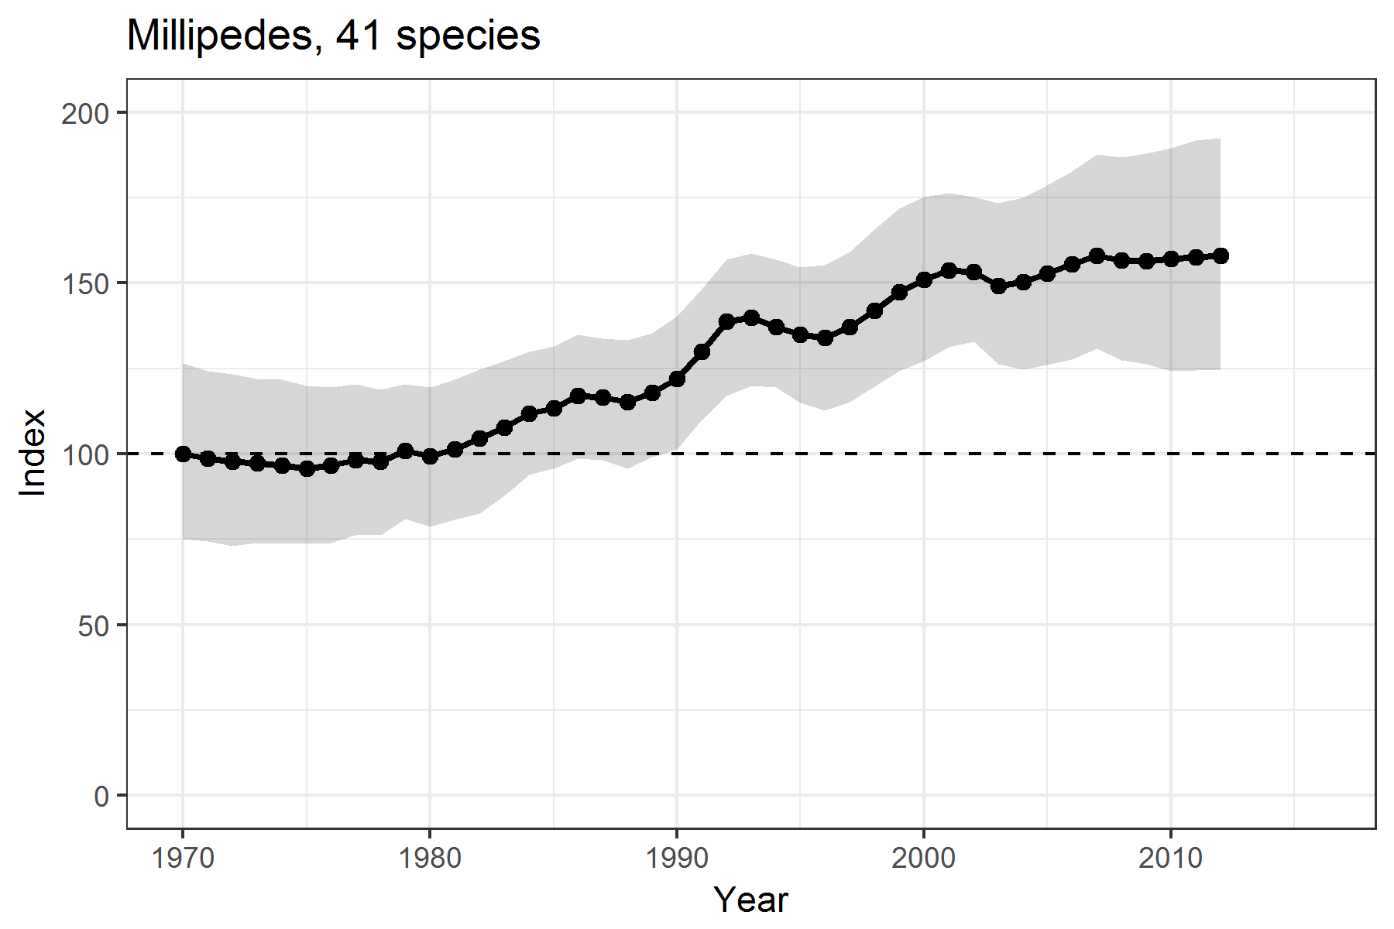
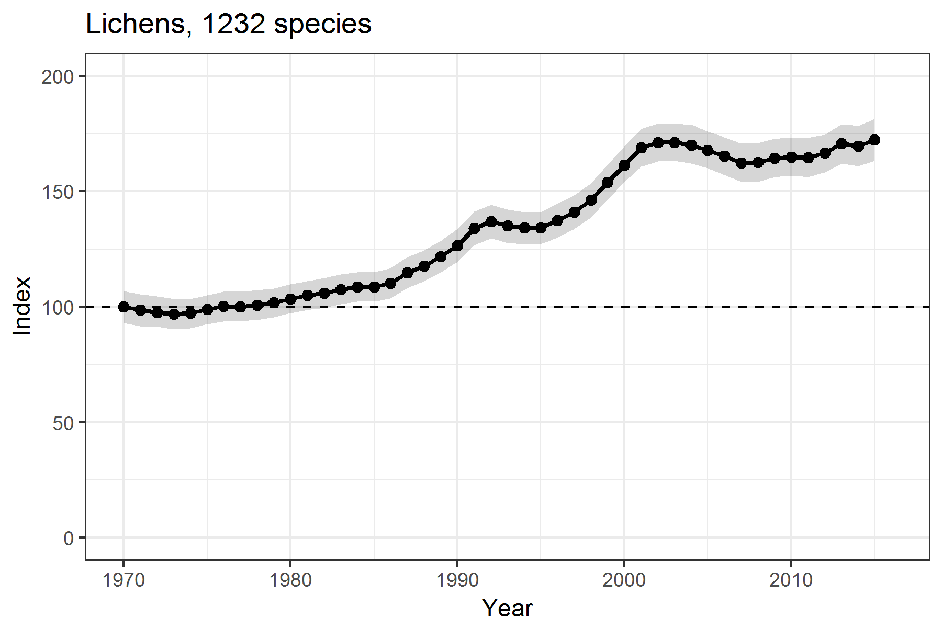
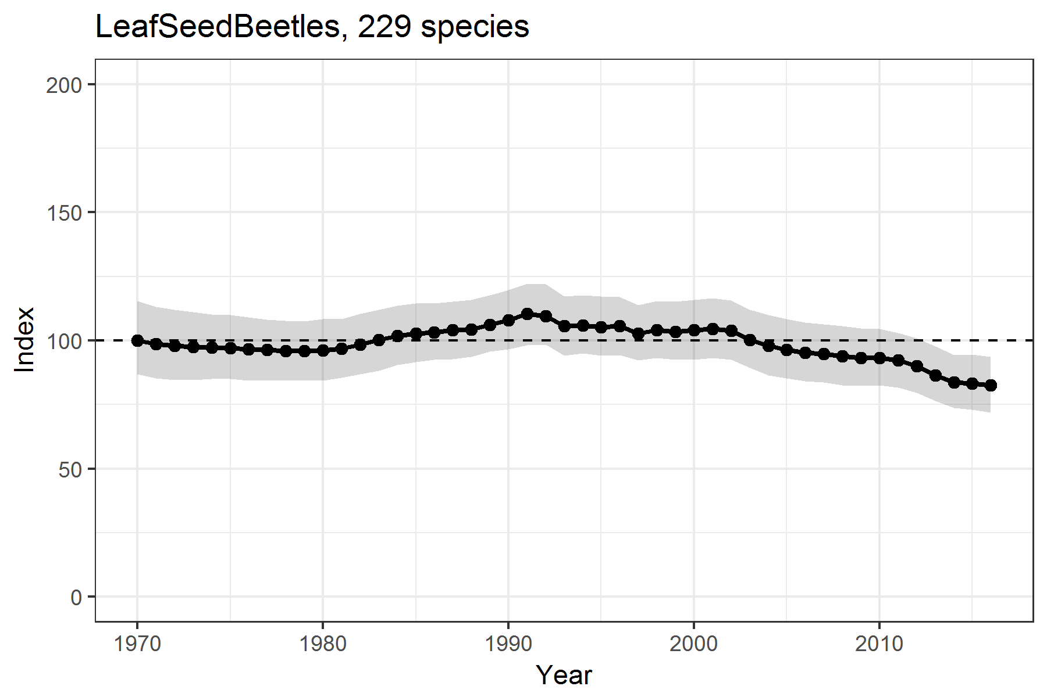
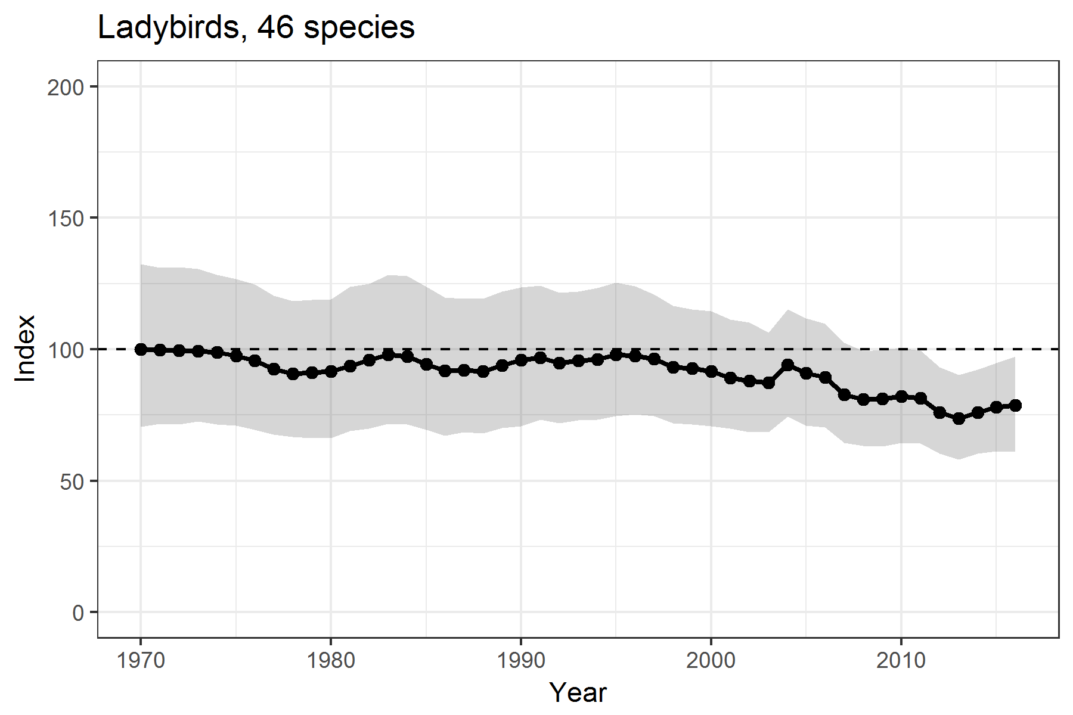
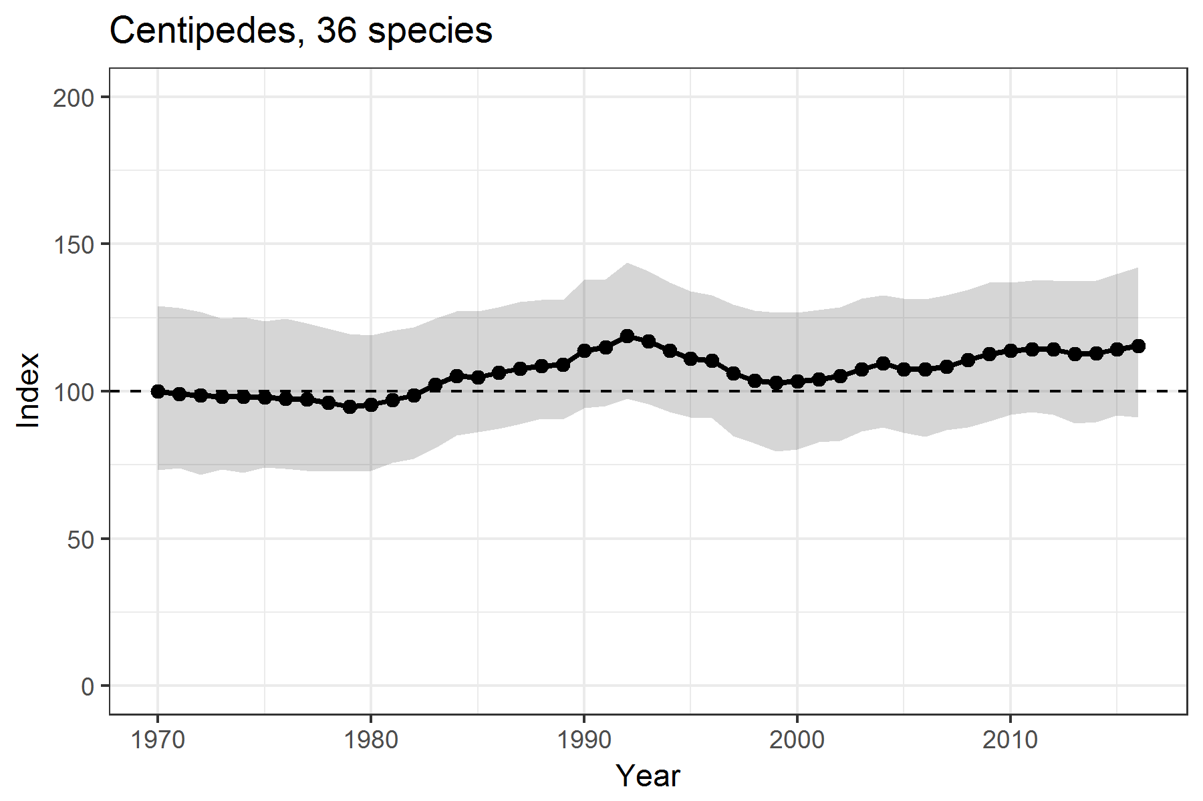
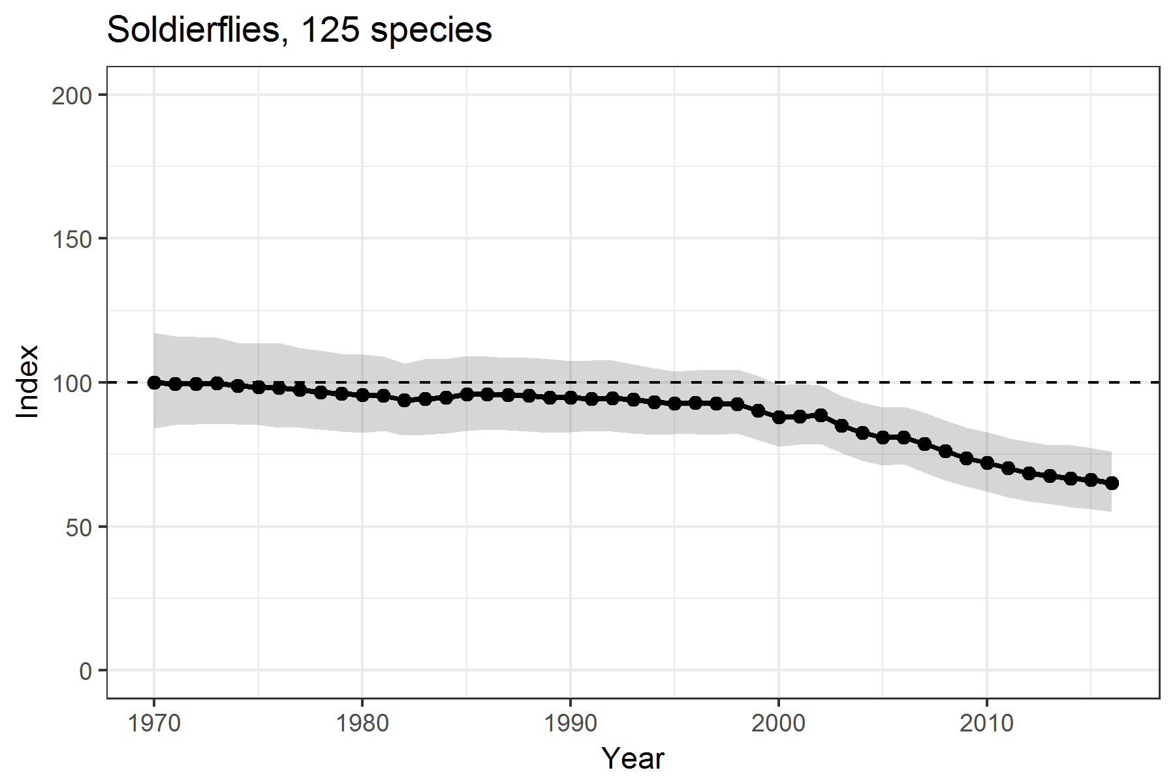
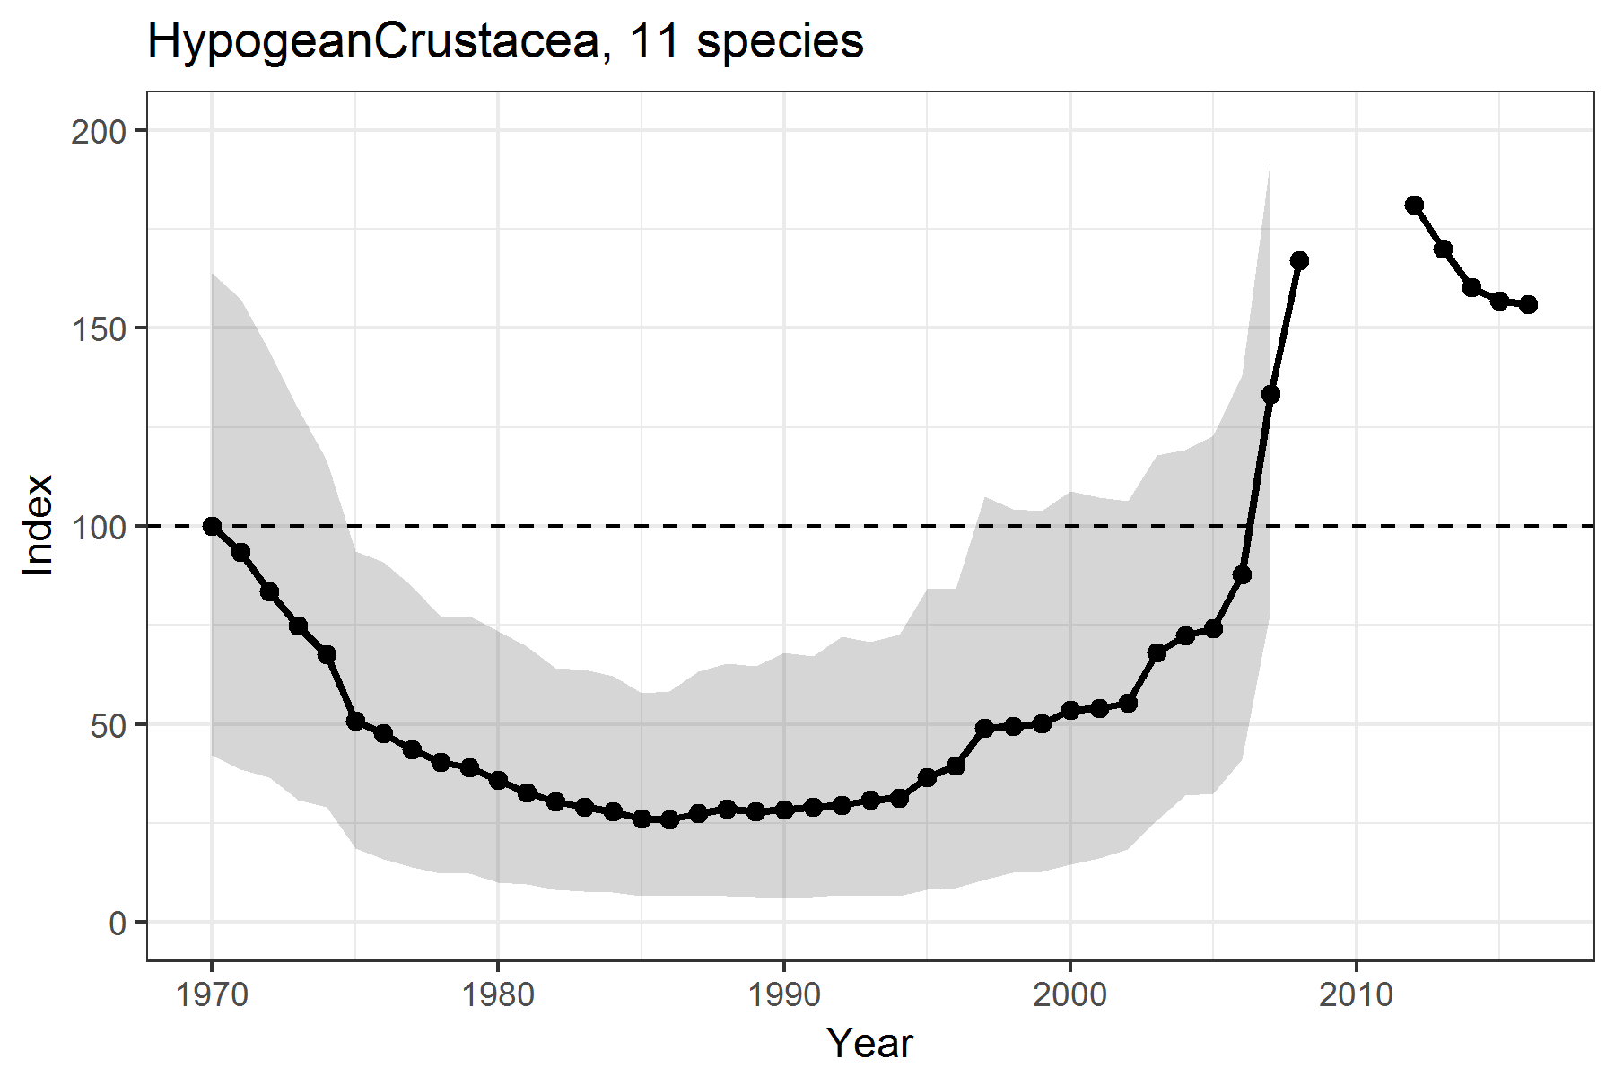
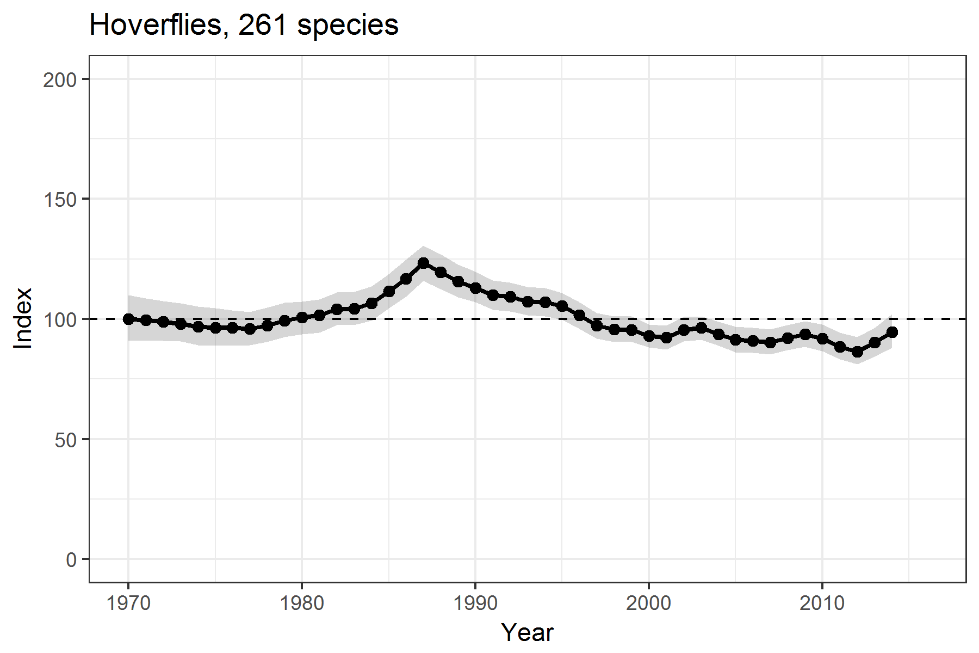
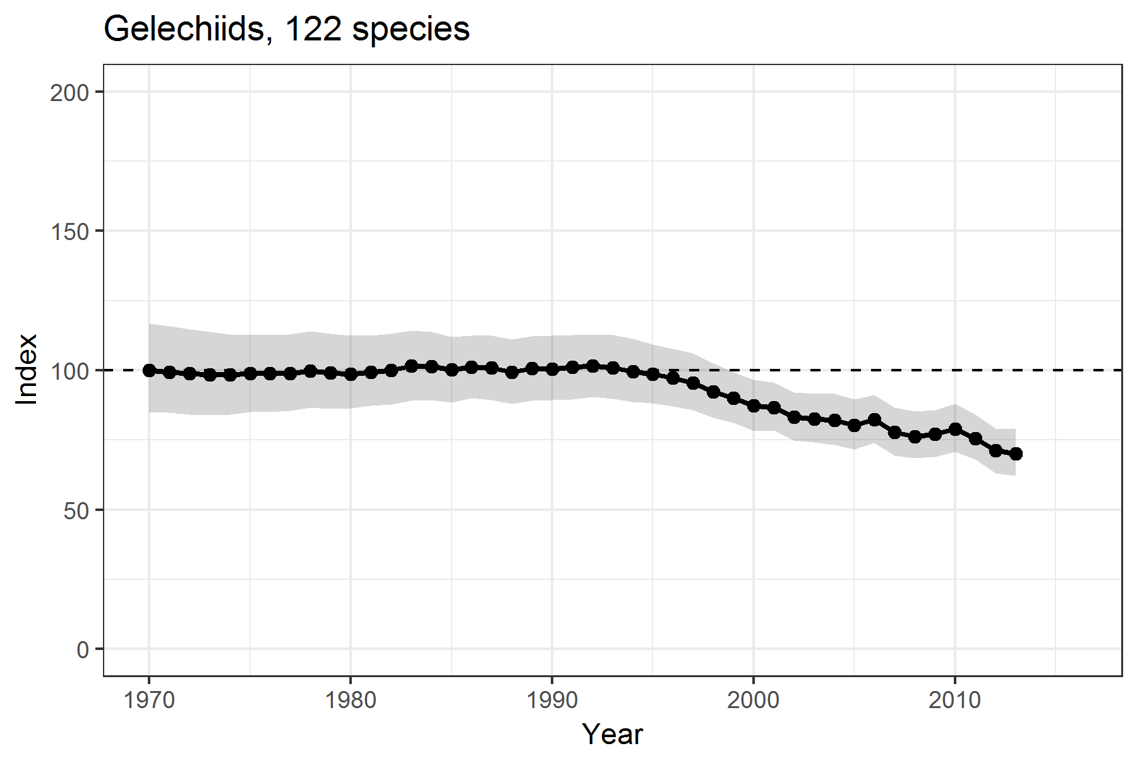
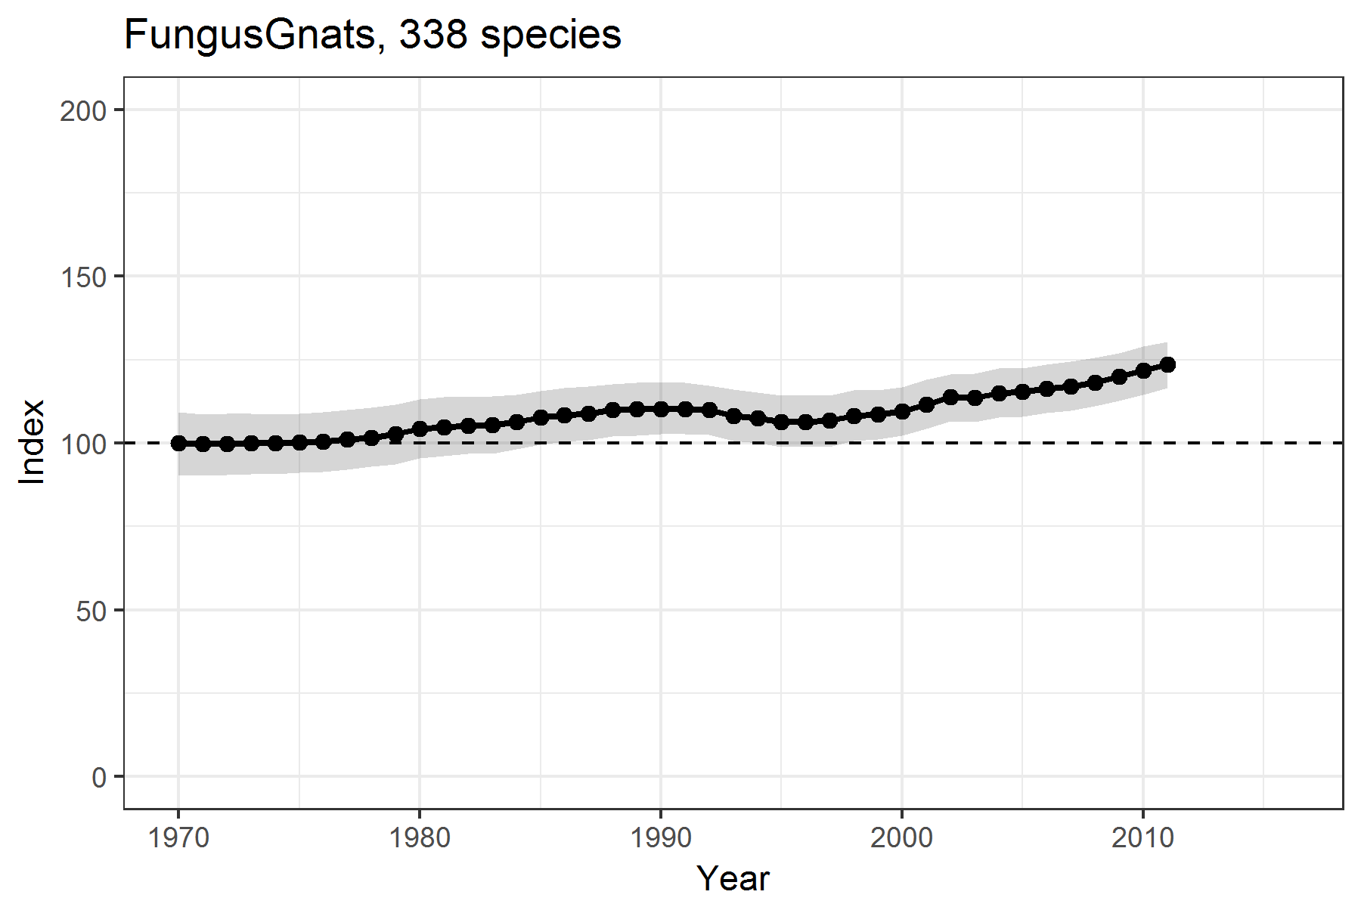
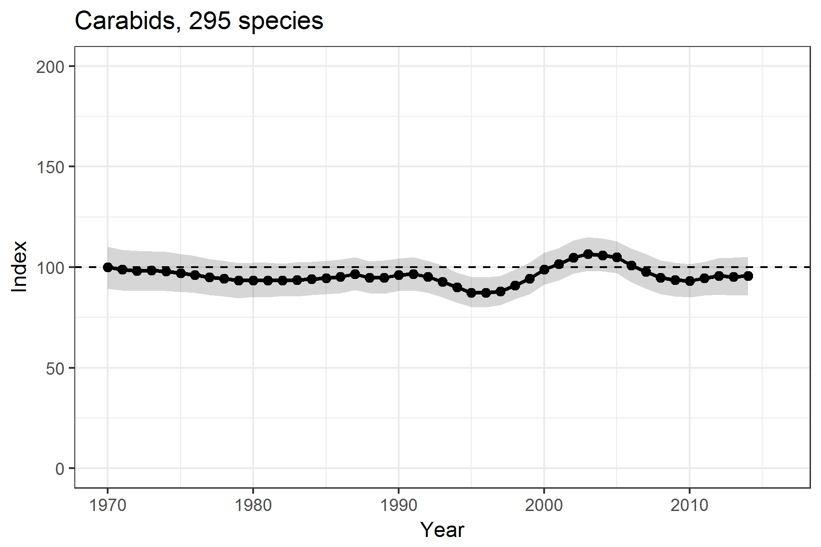
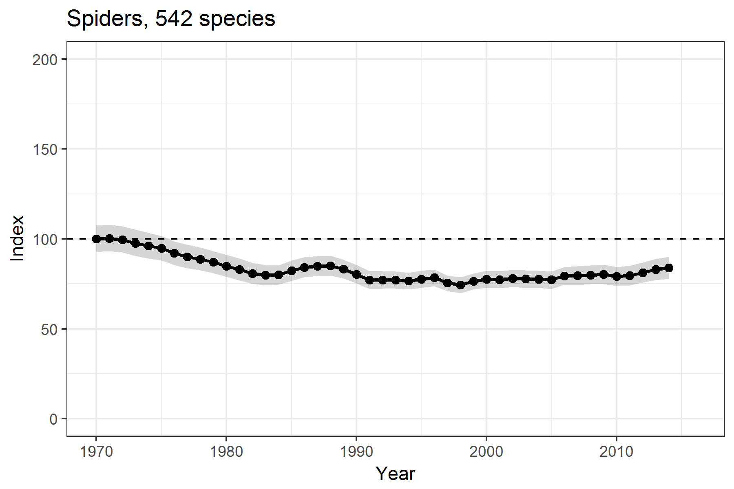
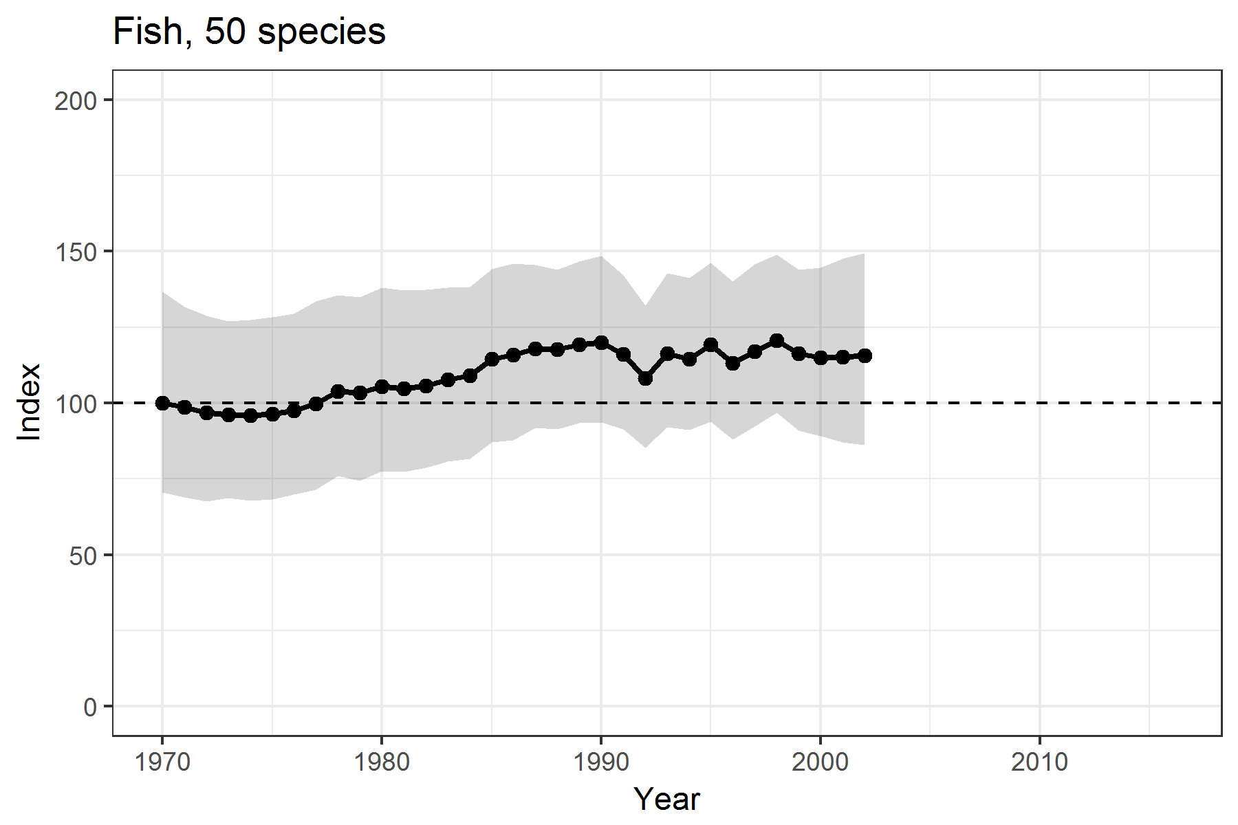
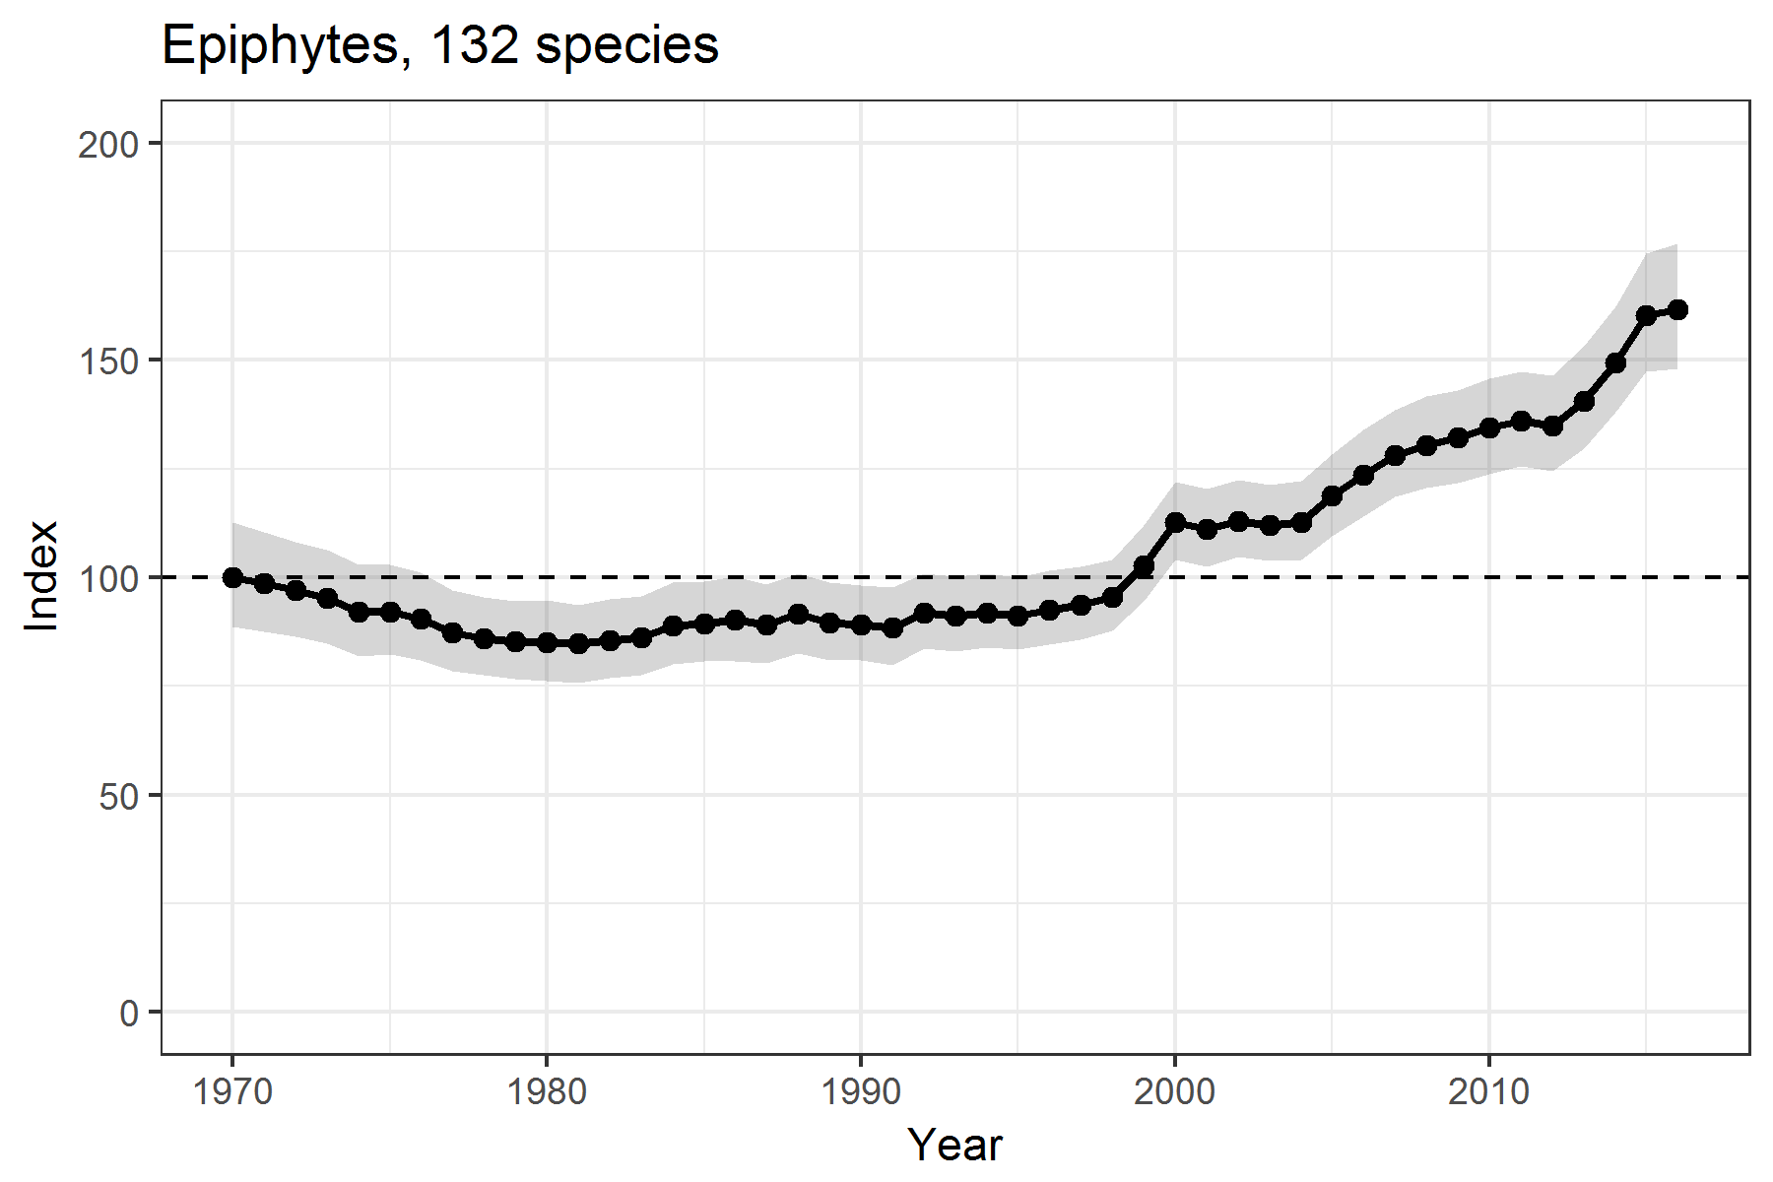
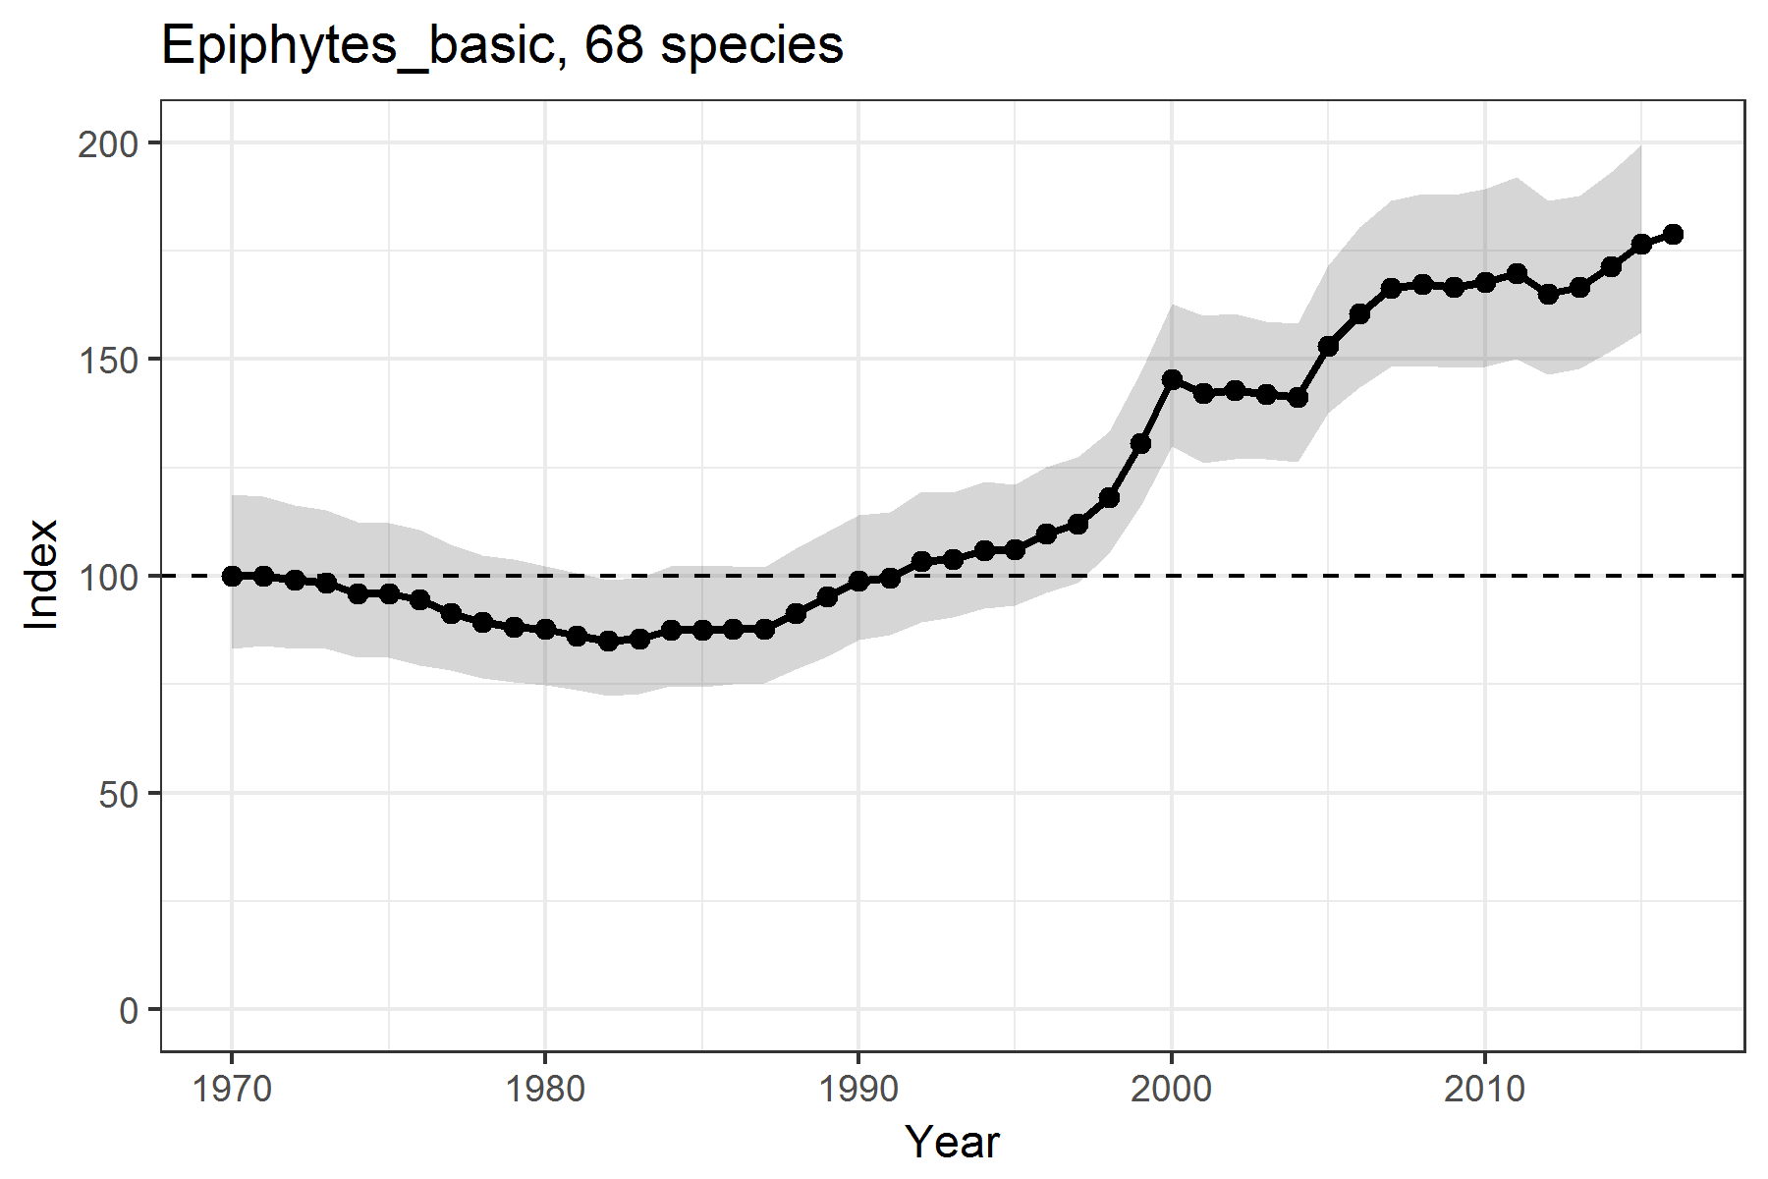
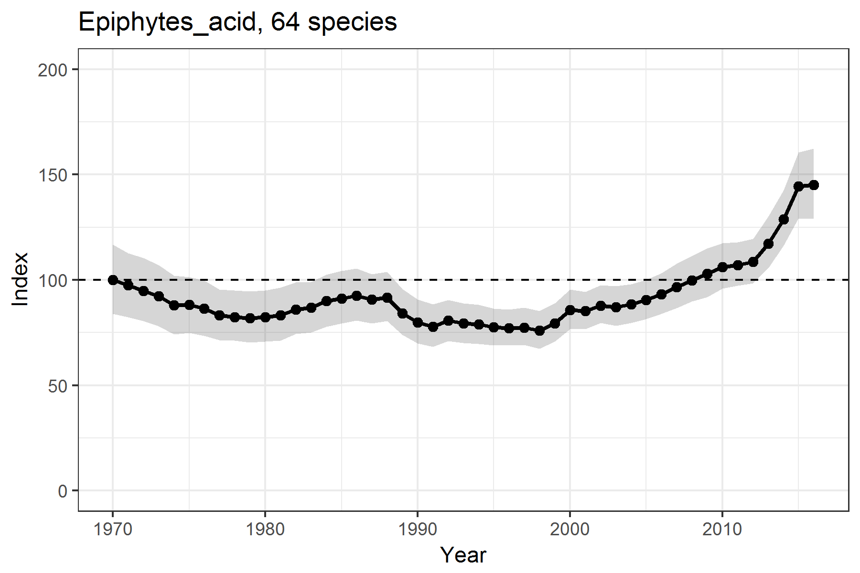
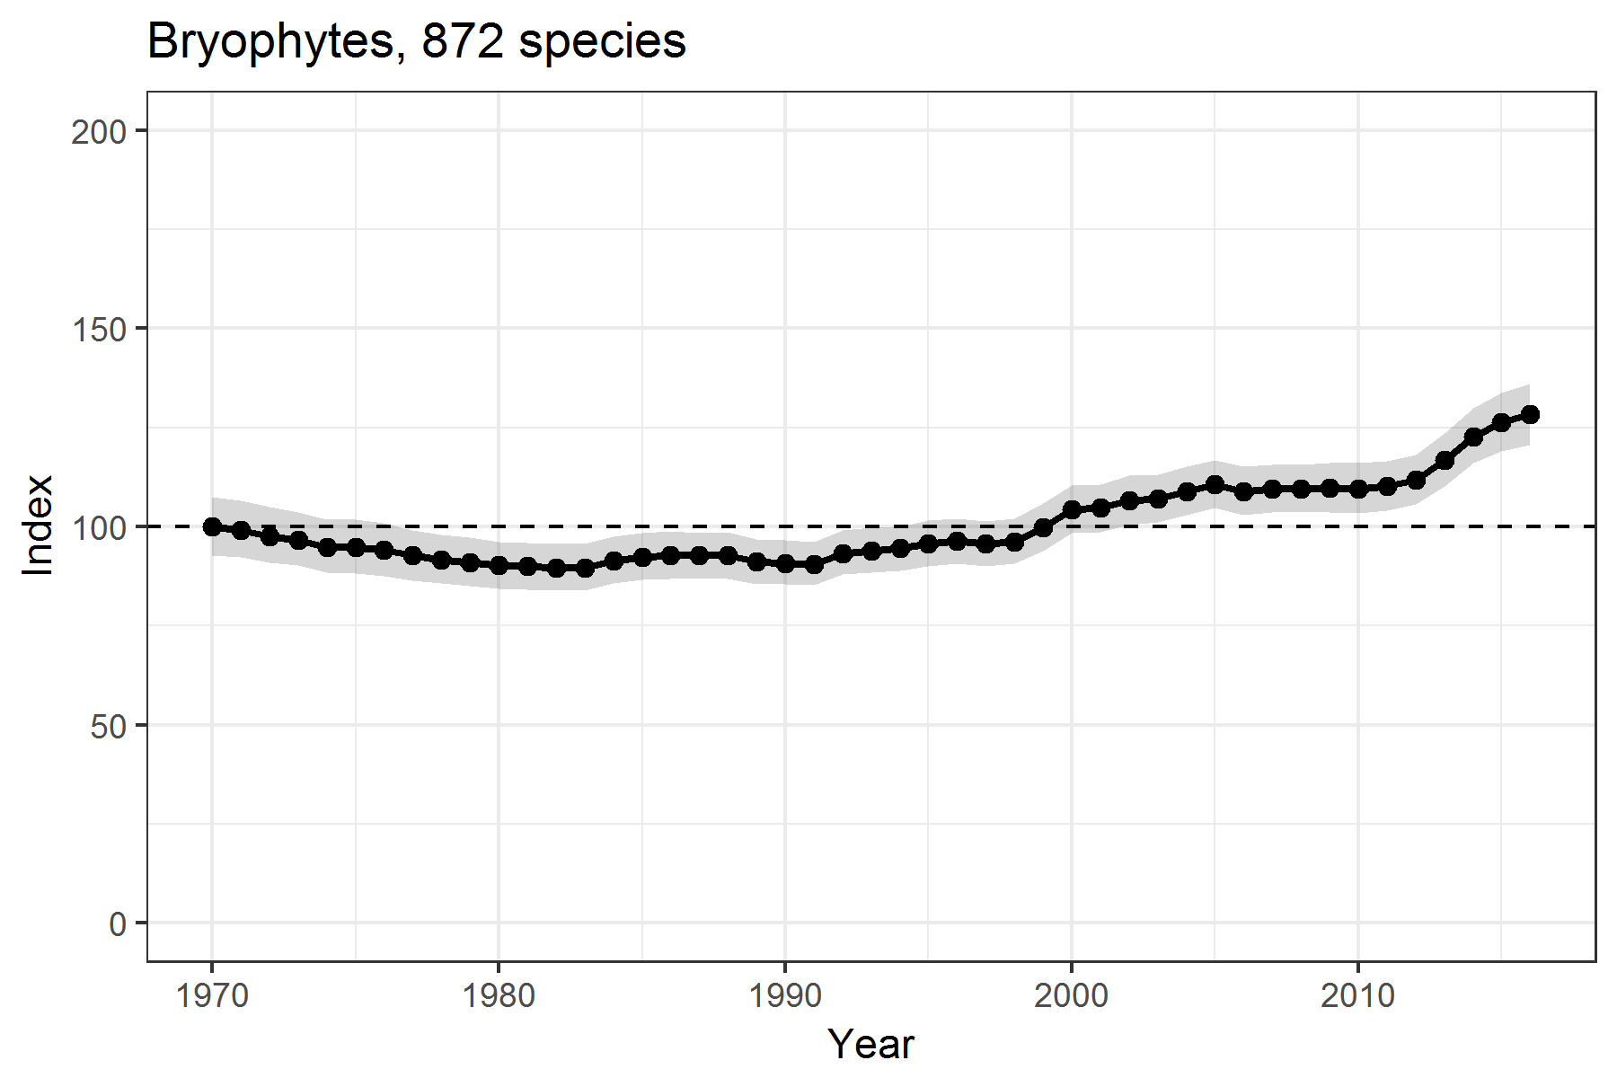
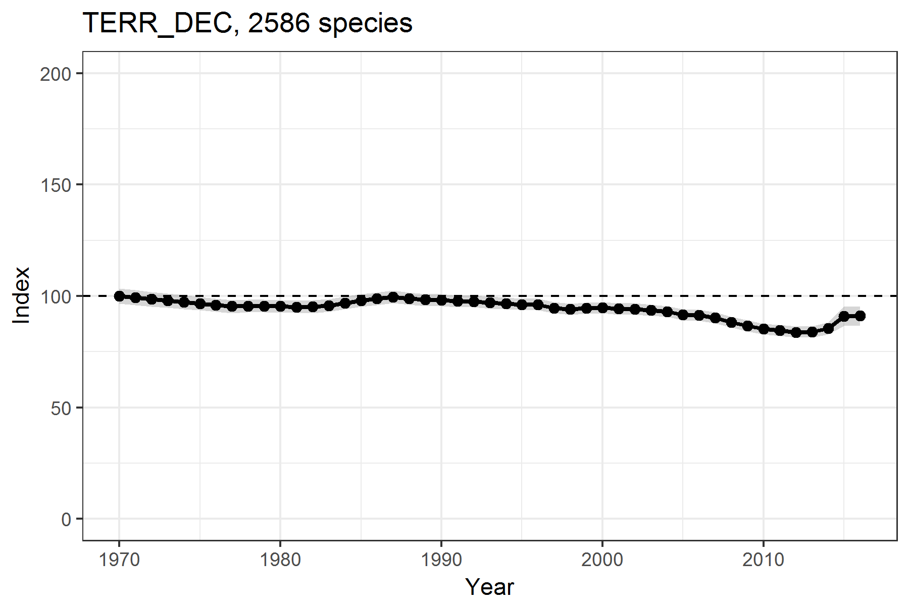
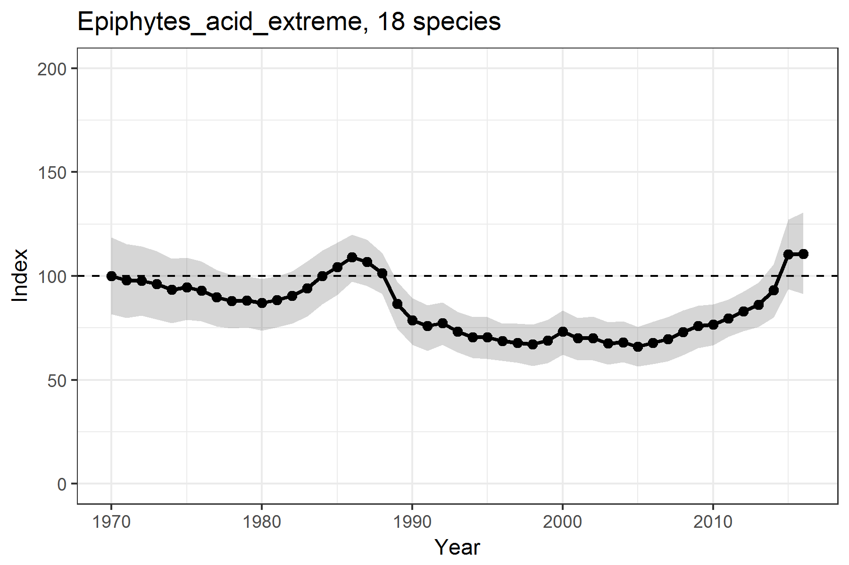
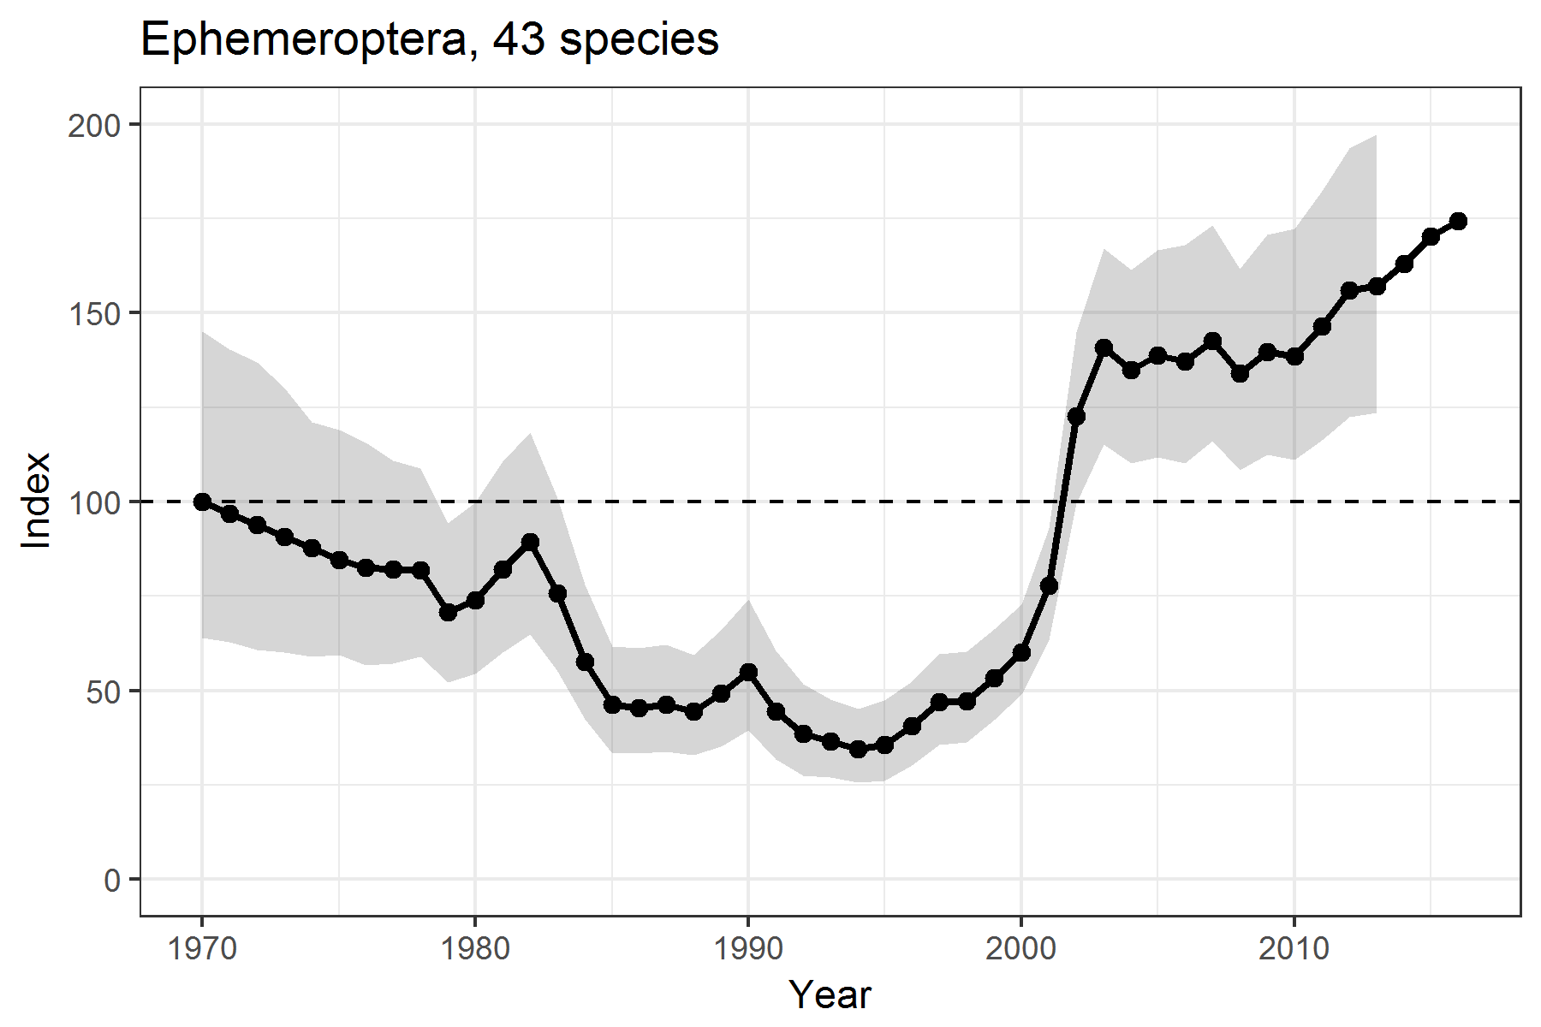
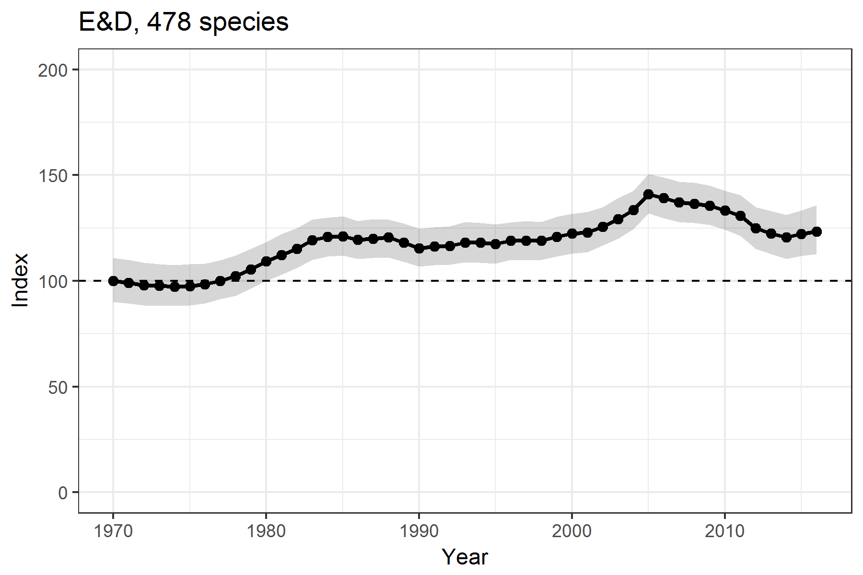
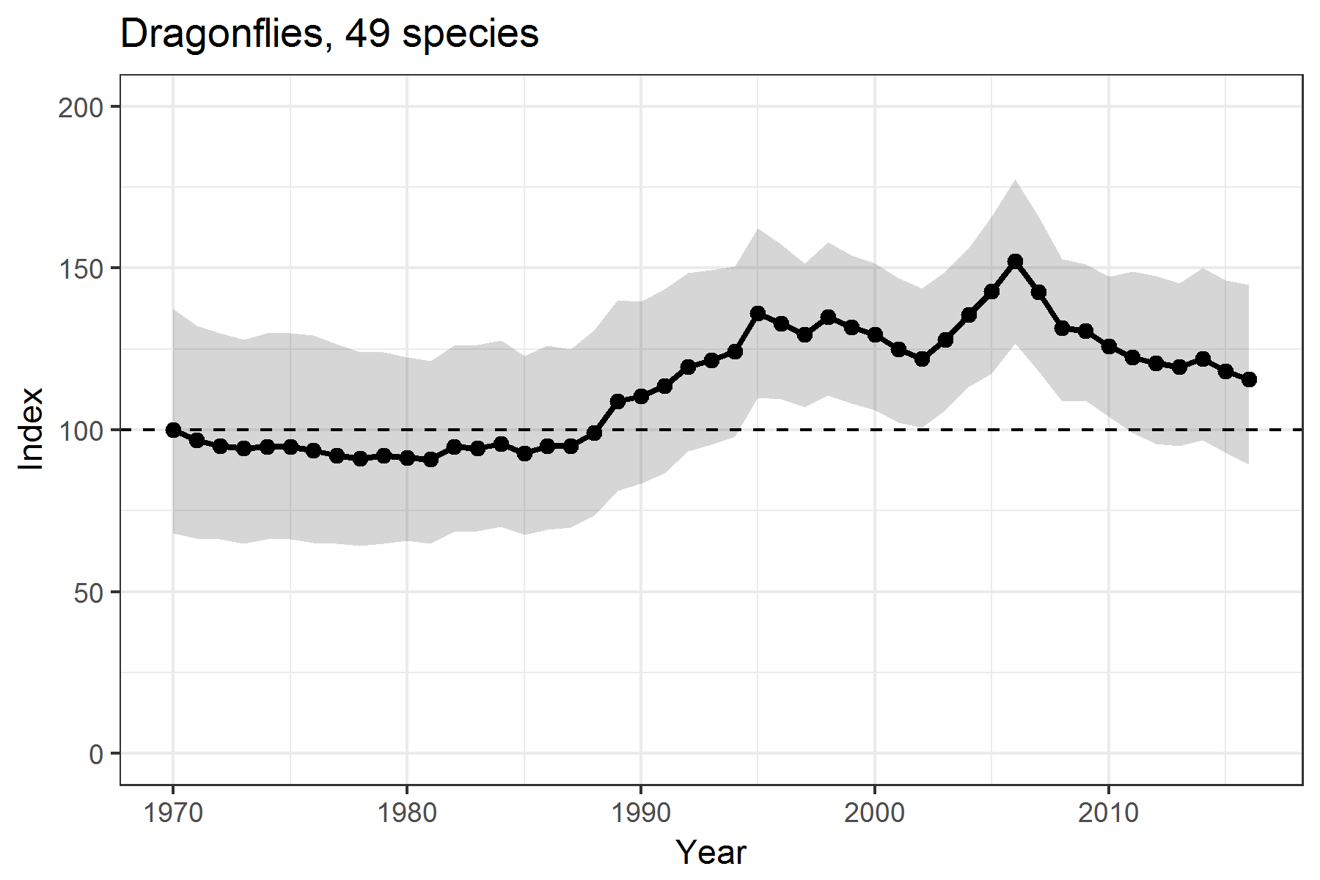
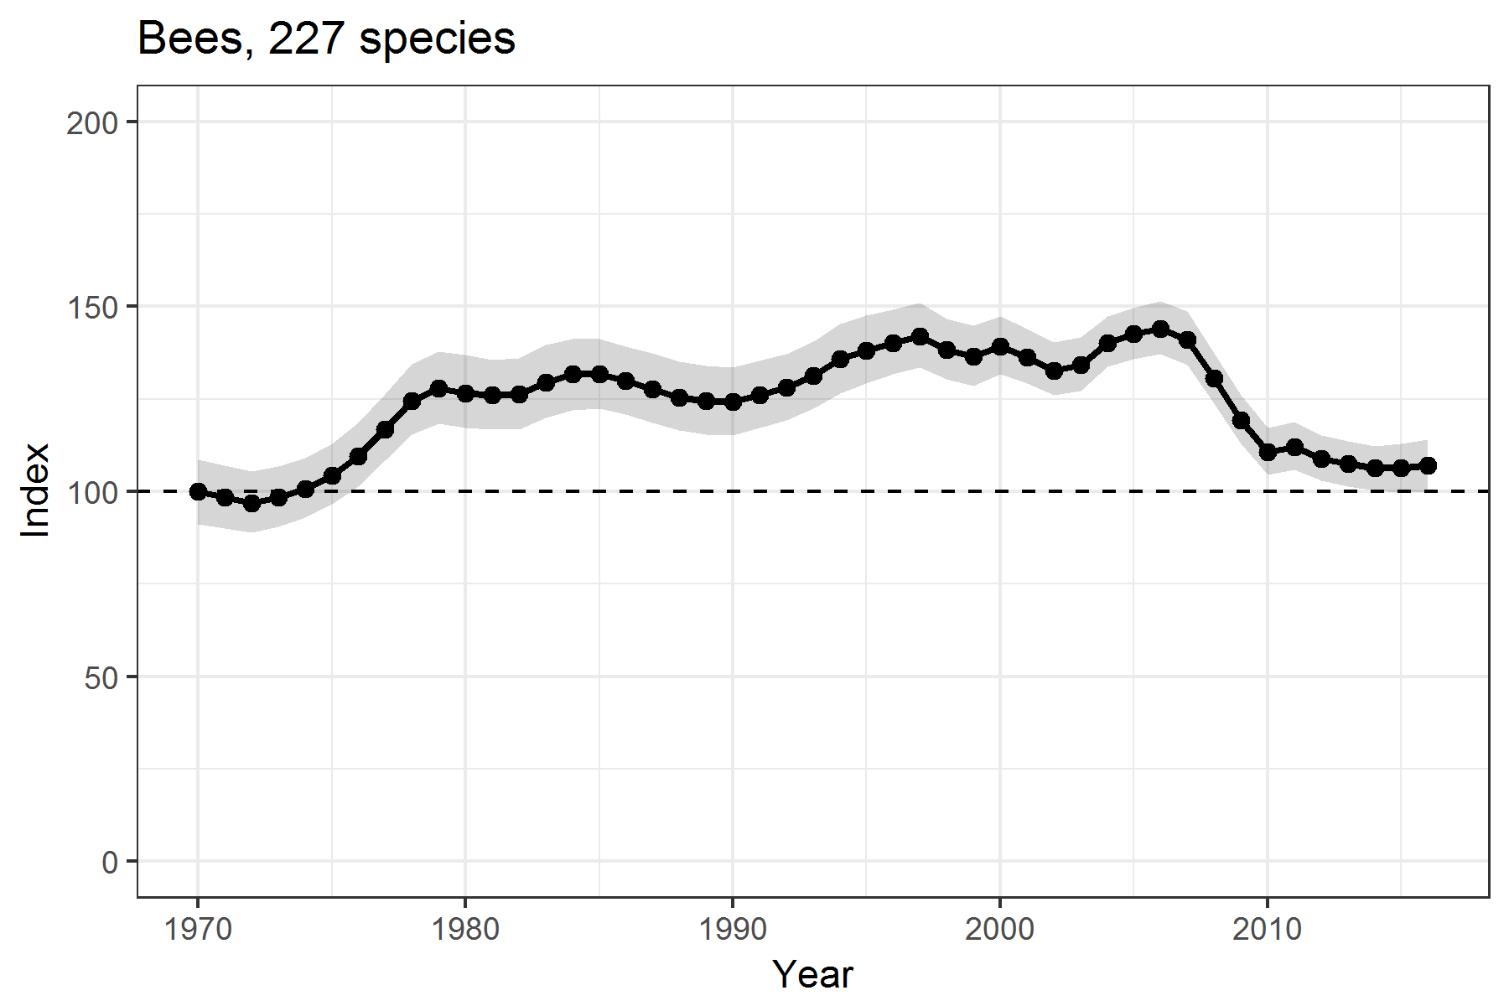
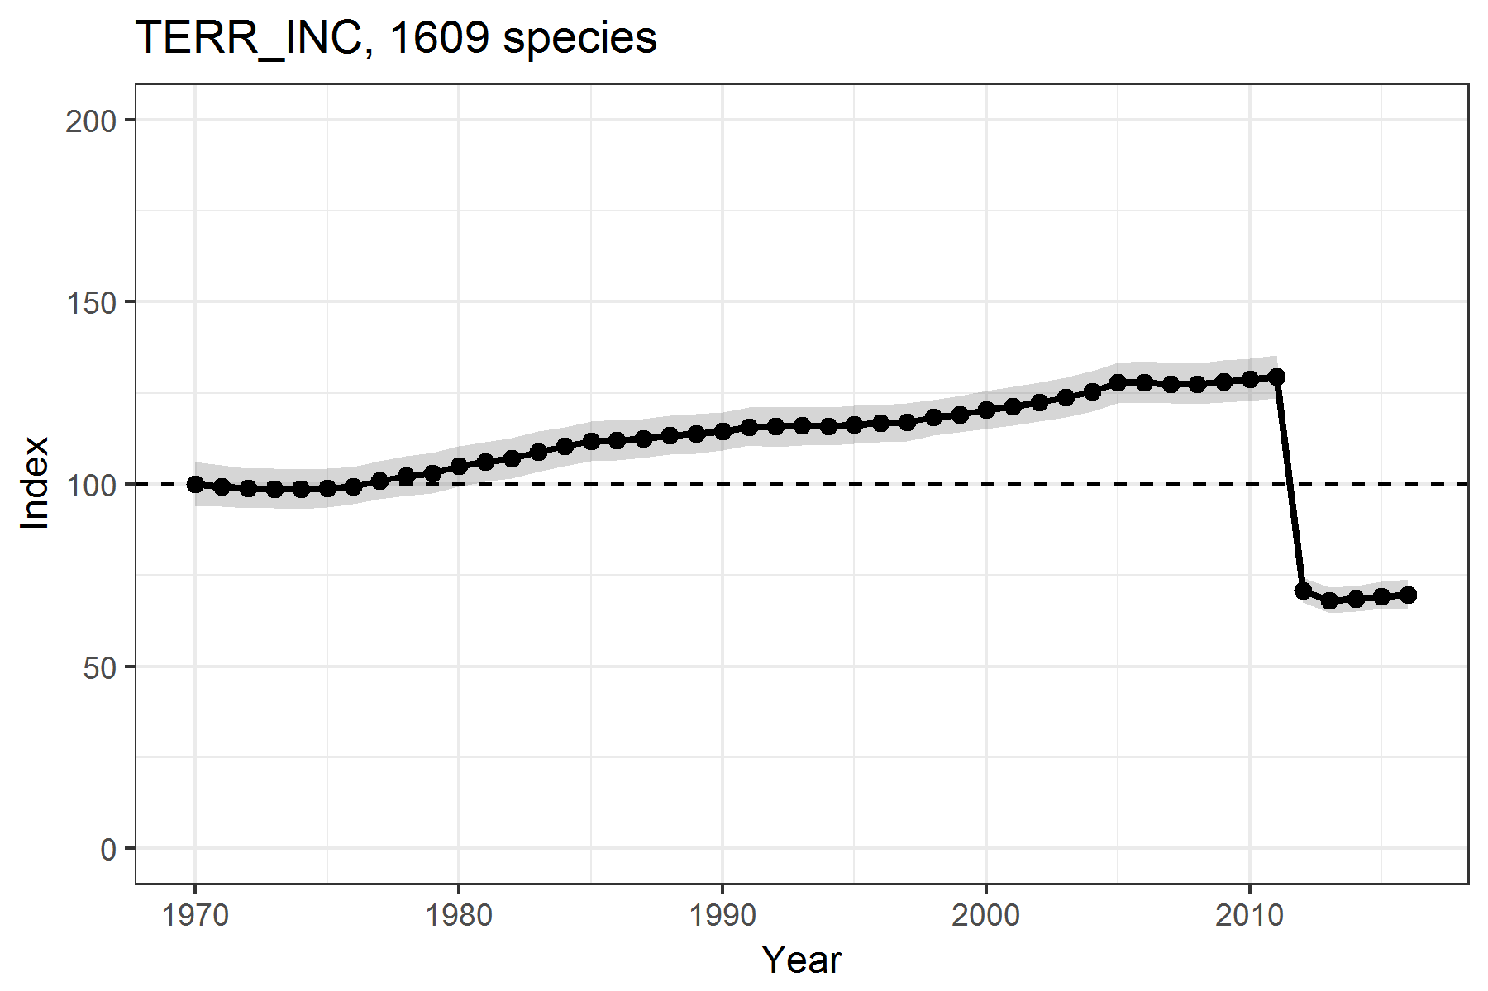
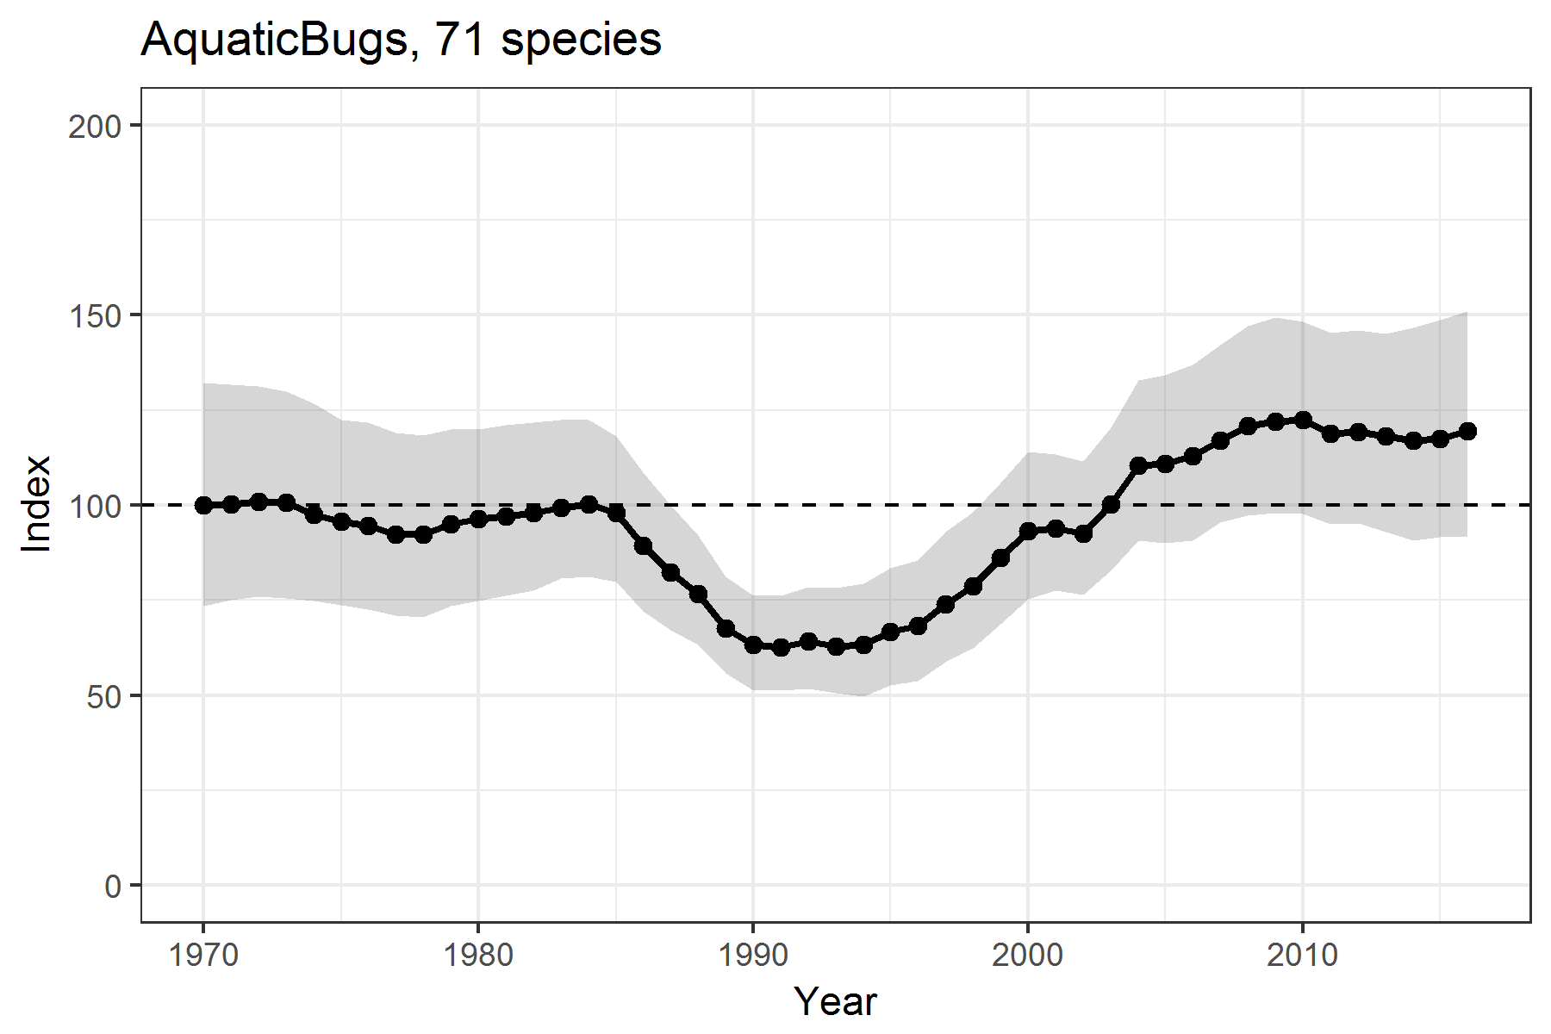
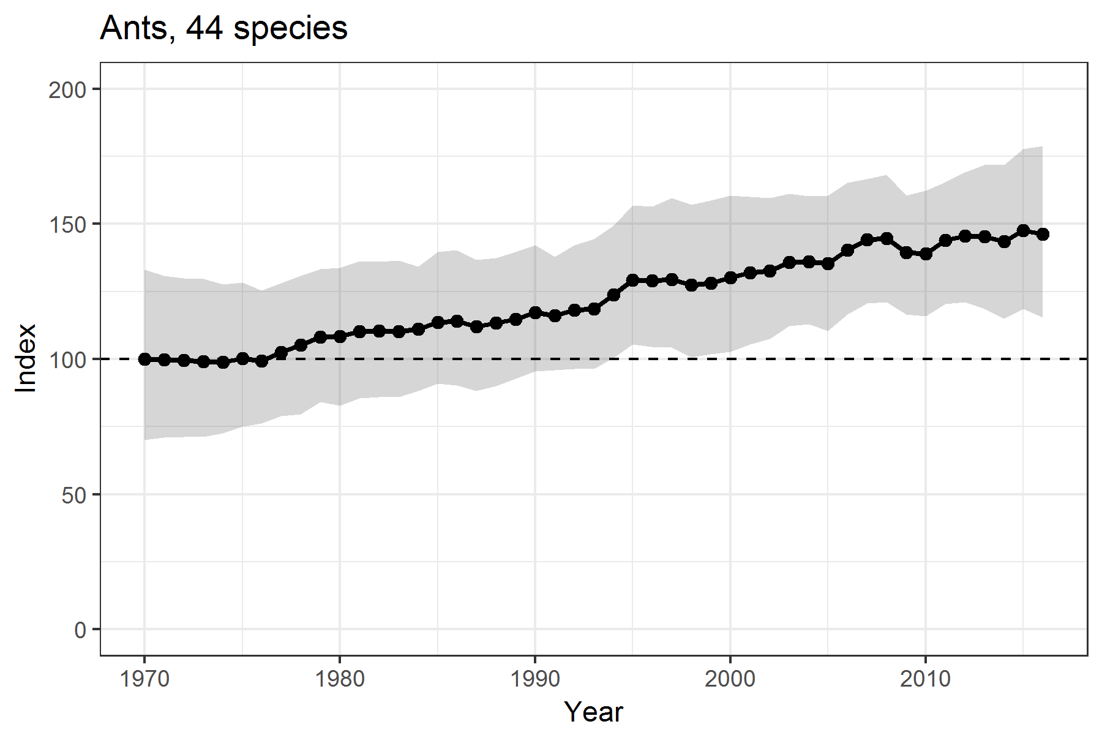
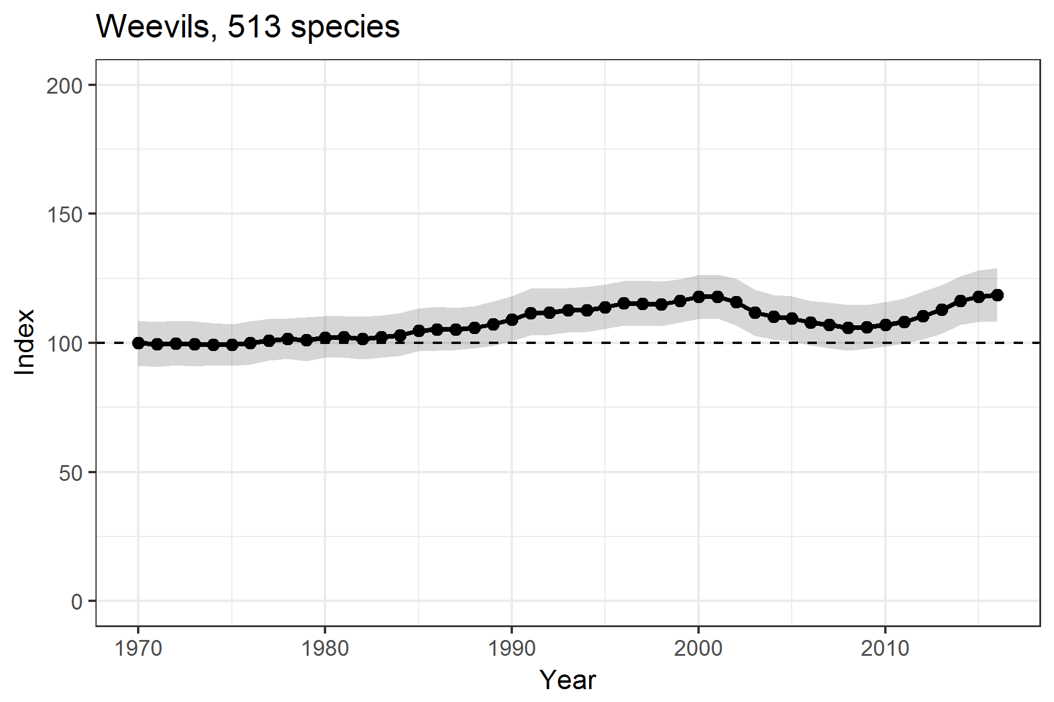
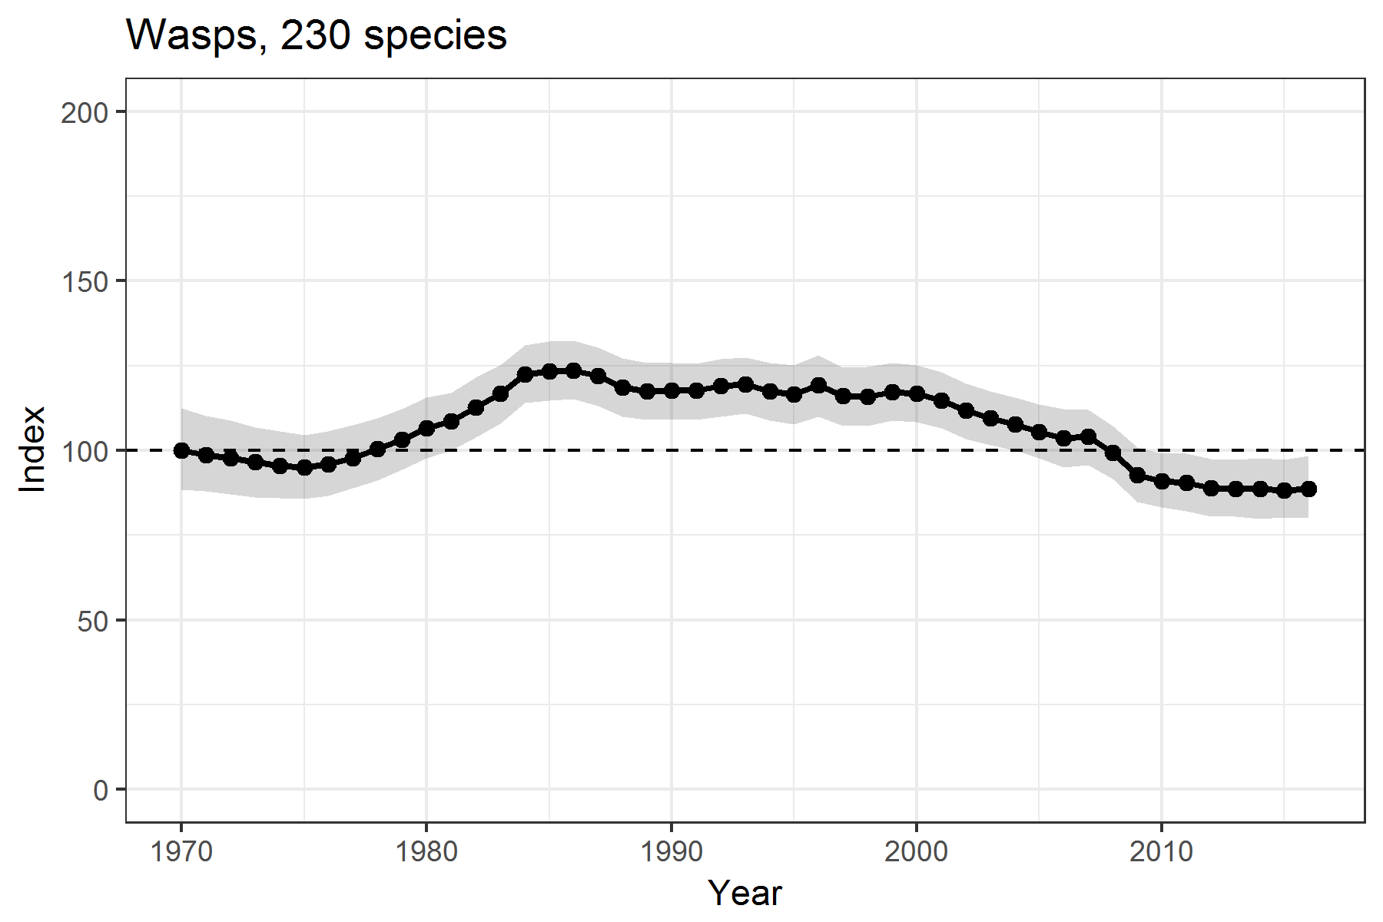
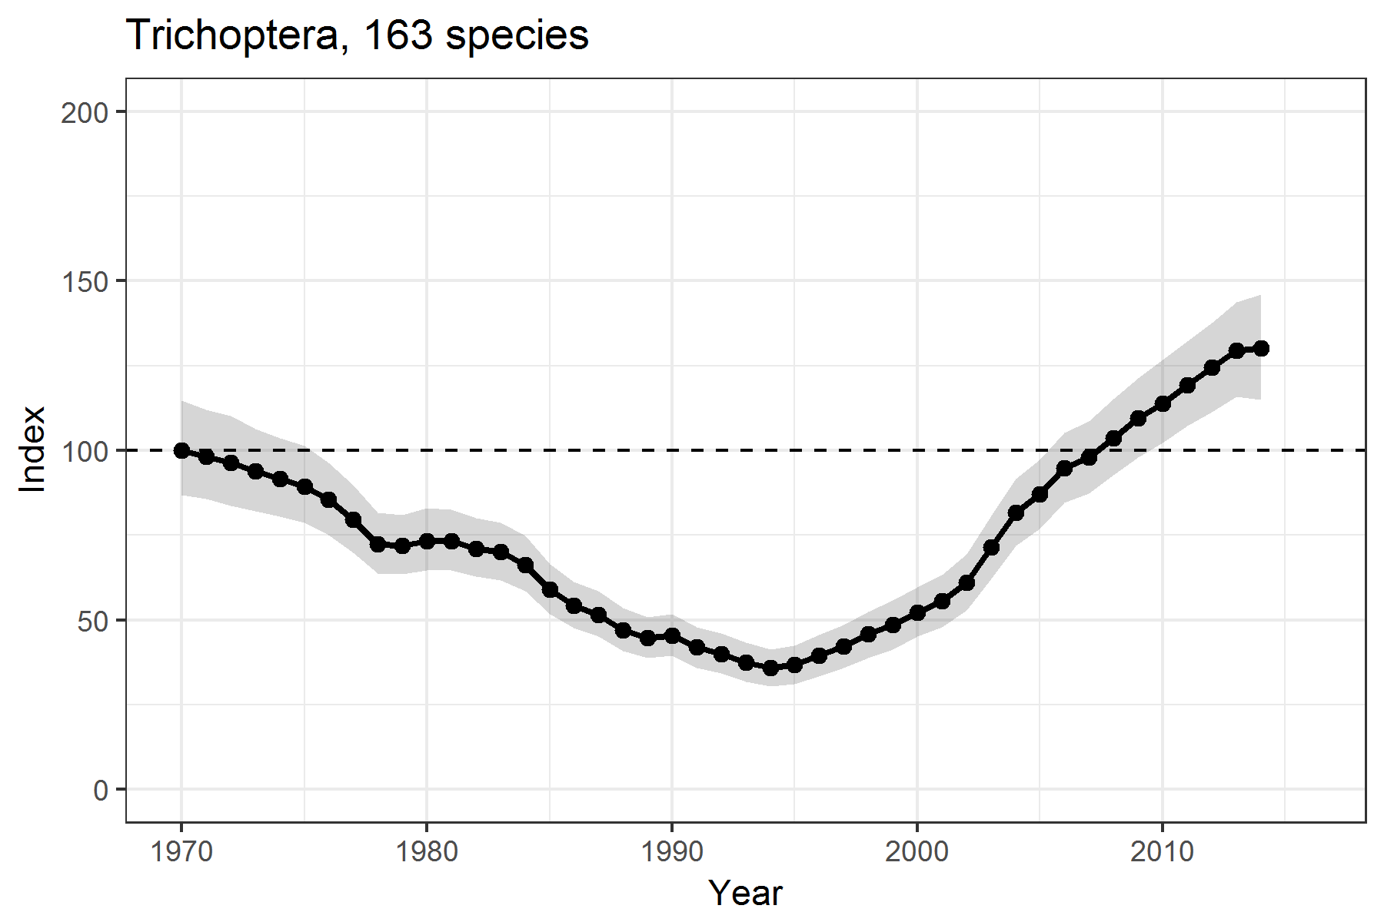
Why do I need High Performance Computing?
You need more processors because you have a lot of tasks to run
You need a lot of memory because you are working with very large models/data sets

Slide 4
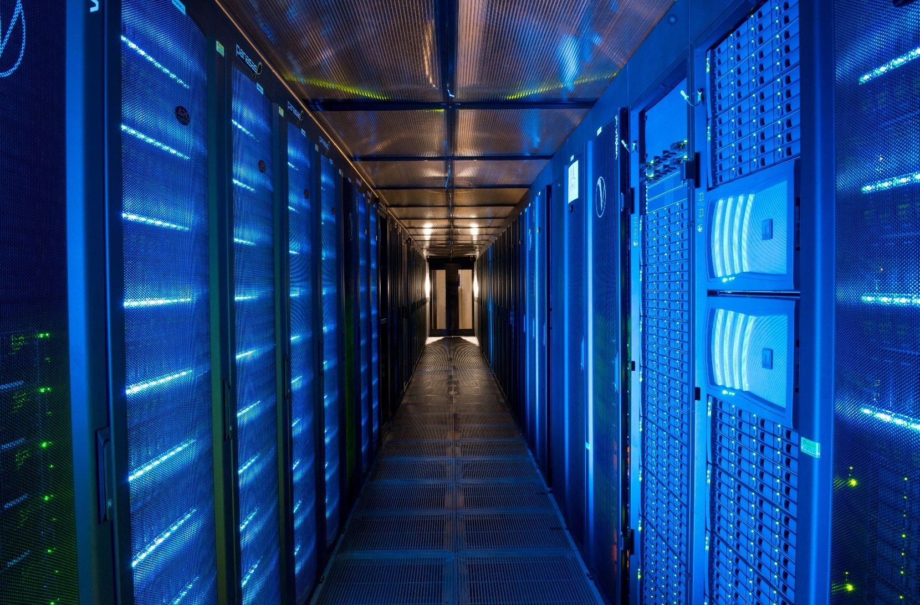
What Facilities are available to me?
CIRRUS – Wallingford Cluster
NEMESIS – Edinburgh Cluster
JASMIN – NERC HPC facility

Slide 5
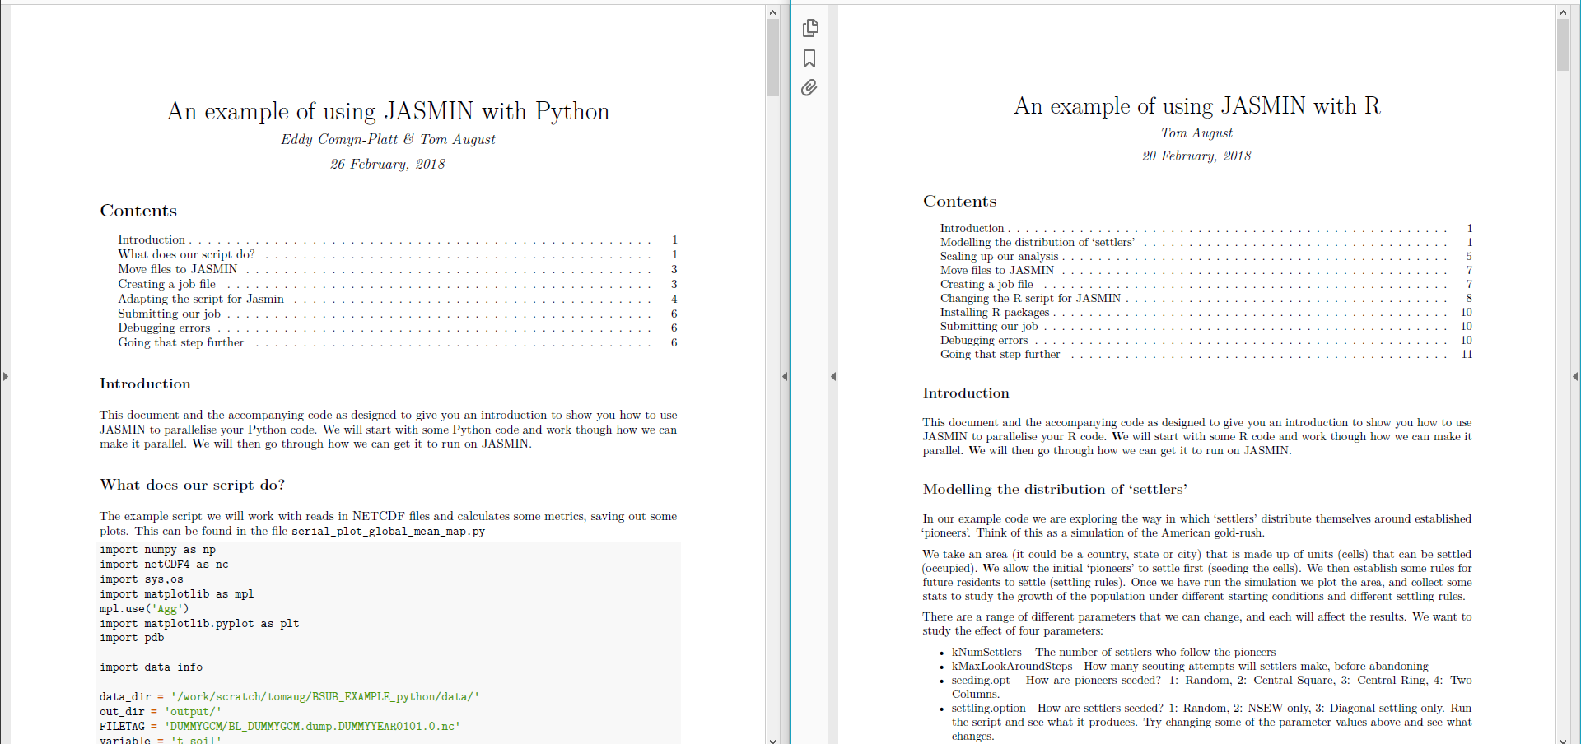
How do I use them?
CIRRUS & NEMESIS – There is help documentation on the intranet
JASMIN – HPC workshops and materials

Slide 6
How easy is it?
source("scripts/simFunctions.R")
library(ggplot2)
library(plyr)
kNumReplications <- 5
# Size of the area
areaW <- 30
areaH <- 30
# Homesteaders, they don't care about finding a neighbor
# only used in random seeding
numPioneers <- 30
parameters <- read.csv('data/parameters.csv')
# Record the time so we know how long it takes
start <- Sys.time()
for(i in (1:nrow(parameters))){
cat('\n\nStarting parameter set', i, '\n')
#These are the people who follow the pioneers
kNumSettlers <- parameters[i, 'kNumSettlers']
# How many scouting attempts will settlers make, before abandoning
kMaxLookAroundSteps <- parameters[i, 'kMaxLookAroundSteps']
#Try out different seeding rules
# (1:Random) (2: Central Square) (3:Central Ring) ( 4: Two Columns)
seeding.opt <- parameters[i, 'seeding.opt']
# (1: Random) (2:NEWS only) (3:Diagonal settling only)
settling.option <- parameters[i, 'settling.option']
adjacells <- getAdjacentCellsDataFrame()
# Make multiple runs (Replication of simulation) and take the average of stats
st <- data.frame()
st_row <- vector()
for(i in 1:kNumReplications) {
area_df <- resetIteration()
seedAreaWithPioneers(numPioneers,seeding.opt)
simstats <- accommodateSettlers(kNumSettlers, settling.option)
found.home <- simstats[1]
max.look.around <- simstats[2]
#compute for this iterations
st_row <- store_iteration_stats(i, kNumSettlers, found.home, max.look.around)
st <- rbind(st,st_row)
}
# Render plot
plotname <- paste0('Pop_map_',
paste(kNumSettlers, kMaxLookAroundSteps, seeding.opt, settling.option, sep = '_'),
'.png')
png(filename = file.path('output_figures', plotname),
width = 6, height = 4, units = 'in', res = 300)
drawArea(area_df)
dev.off()
names(st) <- c("Iter", "FoundHome", "NumSettlers", "Percent")
tablename <- paste0('Pop_table_',
paste(kNumSettlers, kMaxLookAroundSteps, seeding.opt, settling.option, sep = '_'),
'.csv')
write.csv(st, file = file.path('output_tables', tablename), row.names = FALSE)
}
# How long did it take
Sys.time() - start
# Time difference of 28.34115 mins
source("scripts/simFunctions.R")
library(ggplot2)
library(plyr)
kNumReplications <- 5
# Size of the area
areaW <- 30
areaH <- 30
# Homesteaders, they don't care about finding a neighbor
# only used in random seeding
numPioneers <- 30
# Get job index
i <- as.numeric(commandArgs(trailingOnly = TRUE))[1]
parameters <- read.csv('data/parameters.csv')
# Record the time so we know how long it takes
start <- Sys.time()
cat('\n\nStarting parameter set', i, '\n')
#These are the people who follow the pioneers
kNumSettlers <- parameters[i, 'kNumSettlers']
# How many scouting attempts will settlers make, before abandoning
kMaxLookAroundSteps <- parameters[i, 'kMaxLookAroundSteps']
#Try out different seeding rules
# (1:Random) (2: Central Square) (3:Central Ring) ( 4: Two Columns)
seeding.opt <- parameters[i, 'seeding.opt']
# (1: Random) (2:NEWS only) (3:Diagonal settling only)
settling.option <- parameters[i, 'settling.option']
adjacells <- getAdjacentCellsDataFrame()
# Make multiple runs (Replication of simulation) and take the average of stats
st <- data.frame()
st_row <- vector()
for(i in 1:kNumReplications) {
area_df <- resetIteration()
seedAreaWithPioneers(numPioneers,seeding.opt)
simstats <- accommodateSettlers(kNumSettlers, settling.option)
found.home <- simstats[1]
max.look.around <- simstats[2]
#compute for this iterations
st_row <- store_iteration_stats(i, kNumSettlers, found.home, max.look.around)
st <- rbind(st,st_row)
}
# Render plot
plotname <- paste0('Pop_map_',
paste(kNumSettlers, kMaxLookAroundSteps, seeding.opt, settling.option, sep = '_'),
'.png')
png(filename = file.path('output_figures', plotname),
width = 6, height = 4, units = 'in', res = 300)
drawArea(area_df)
dev.off()
names(st) <- c("Iter", "FoundHome", "NumSettlers", "Percent")
tablename <- paste0('Pop_table_',
paste(kNumSettlers, kMaxLookAroundSteps, seeding.opt, settling.option, sep = '_'),
'.csv')
write.csv(st, file = file.path('output_tables', tablename), row.names = FALSE)
# How long did it take
Sys.time() - start
# 3 minutes total

Slide 7
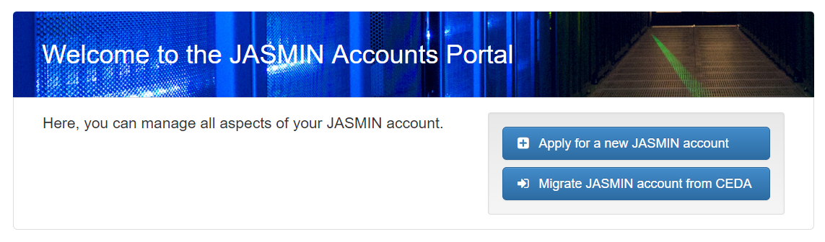
One, Two, Three
Get an account on your HPC
Read tutorials on the intranet, ask for help
Be awesome

